Slide 1
Laha: A Framework for adaptive optimization of distributed sensor frameworks
A Ph.d. dissertation defense
Anthony christe
24 February 2020

Slide 2


DSNs and DSN management: The big picture

Slide 3
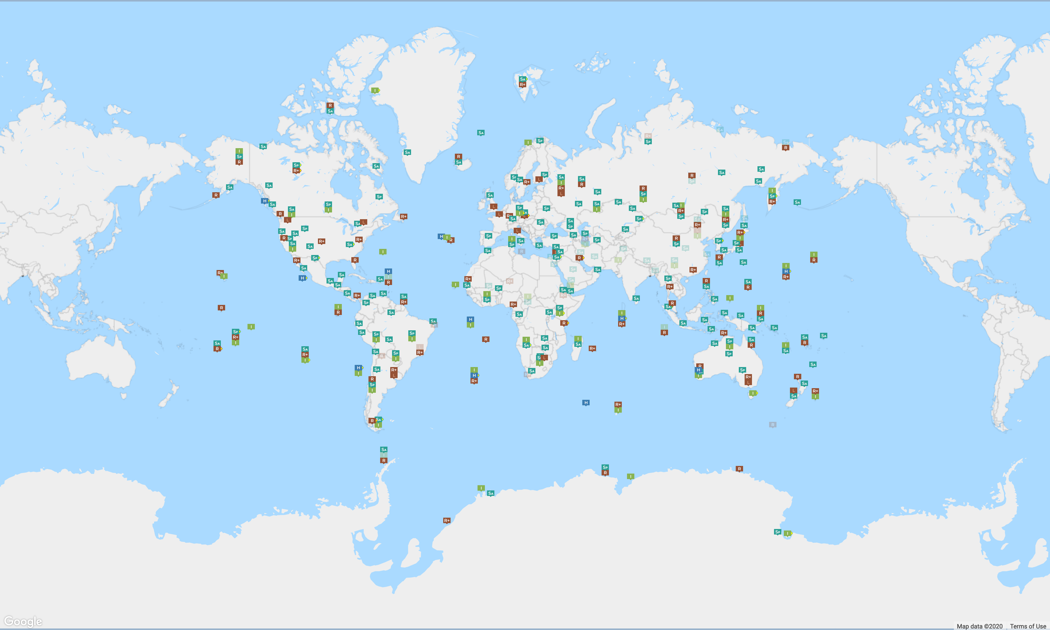
Distributed sensor networks
Source: CTBTO
Notes:
Dynamic, heterogenous/homogenous
Rapidly expanding
Mainly interested in sensor->sink
Increase in multi-modal data decrease in signal-to-noise
Can either keep everything or selectively discard data
As DSNs scale ,available storage must be balanced with amount of data being retained

Slide 4
Major claims of the laha framework
General and useful framework for multiple DSN domains
Convert primitive sensor data into actionable insights
Tiered management of Big Data
Tertiary goals and claims. Optimization of:
Triggering
Detection/Classification
Predictive analytics
Sensing field topology

Slide 5
Laha: A Framework for addressing DSN issues
These capabilities were evaluated and tested in the following ways:
Design of two Laha-compatible DSNs
Deployment of two Laha-compatible DSNs
Validation of data collected by deployments
Evaluation of major goals of Laha
Metrics and Results

Slide 6
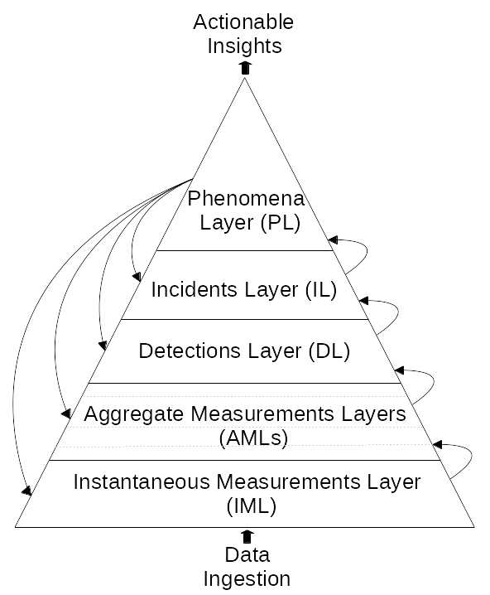
Contribution #1: Laha design
Novel abstract distributed sensor framework
Converting primitive data into actionable insights
Sensor data management
Self-optimization capabilities

Slide 7
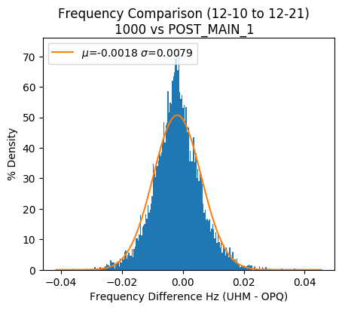
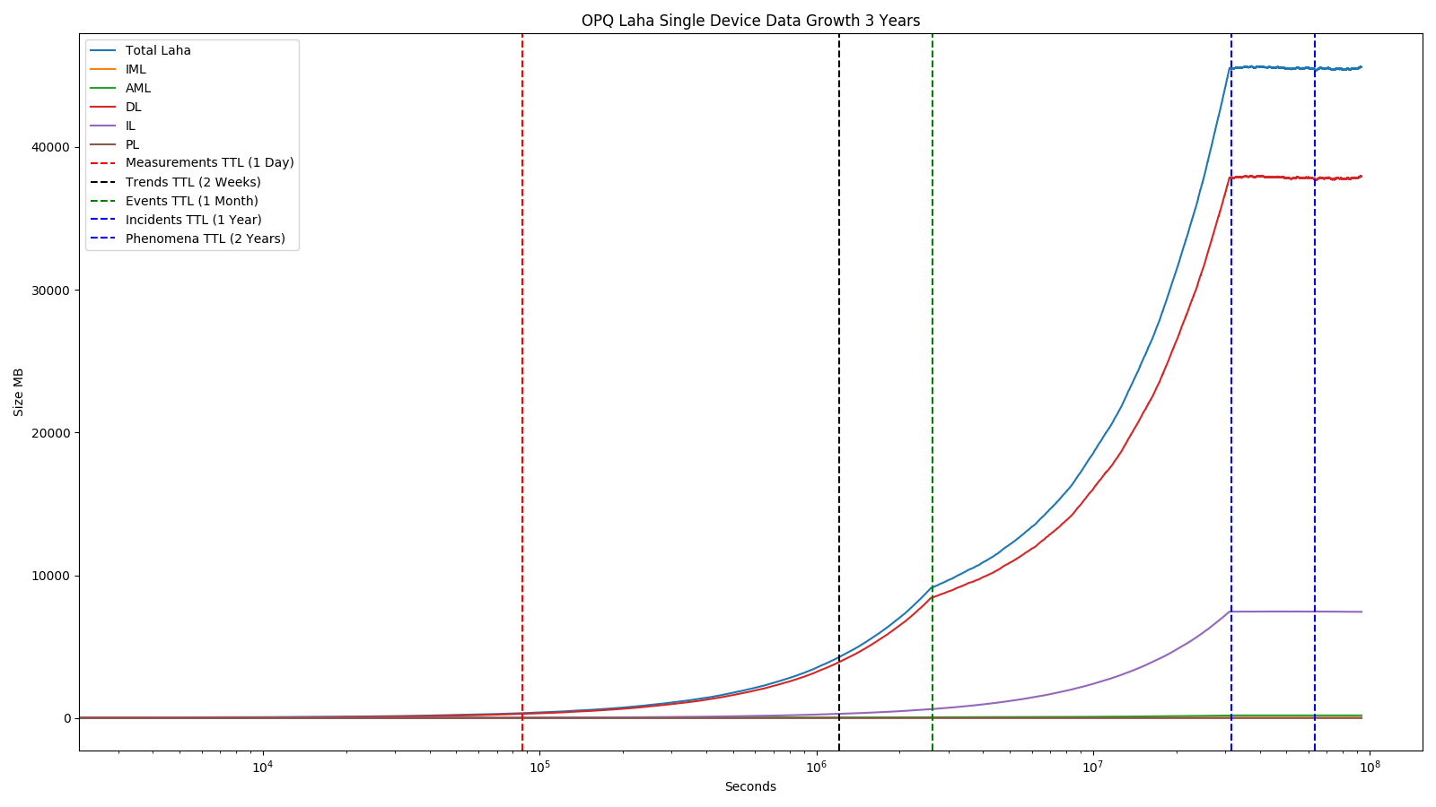
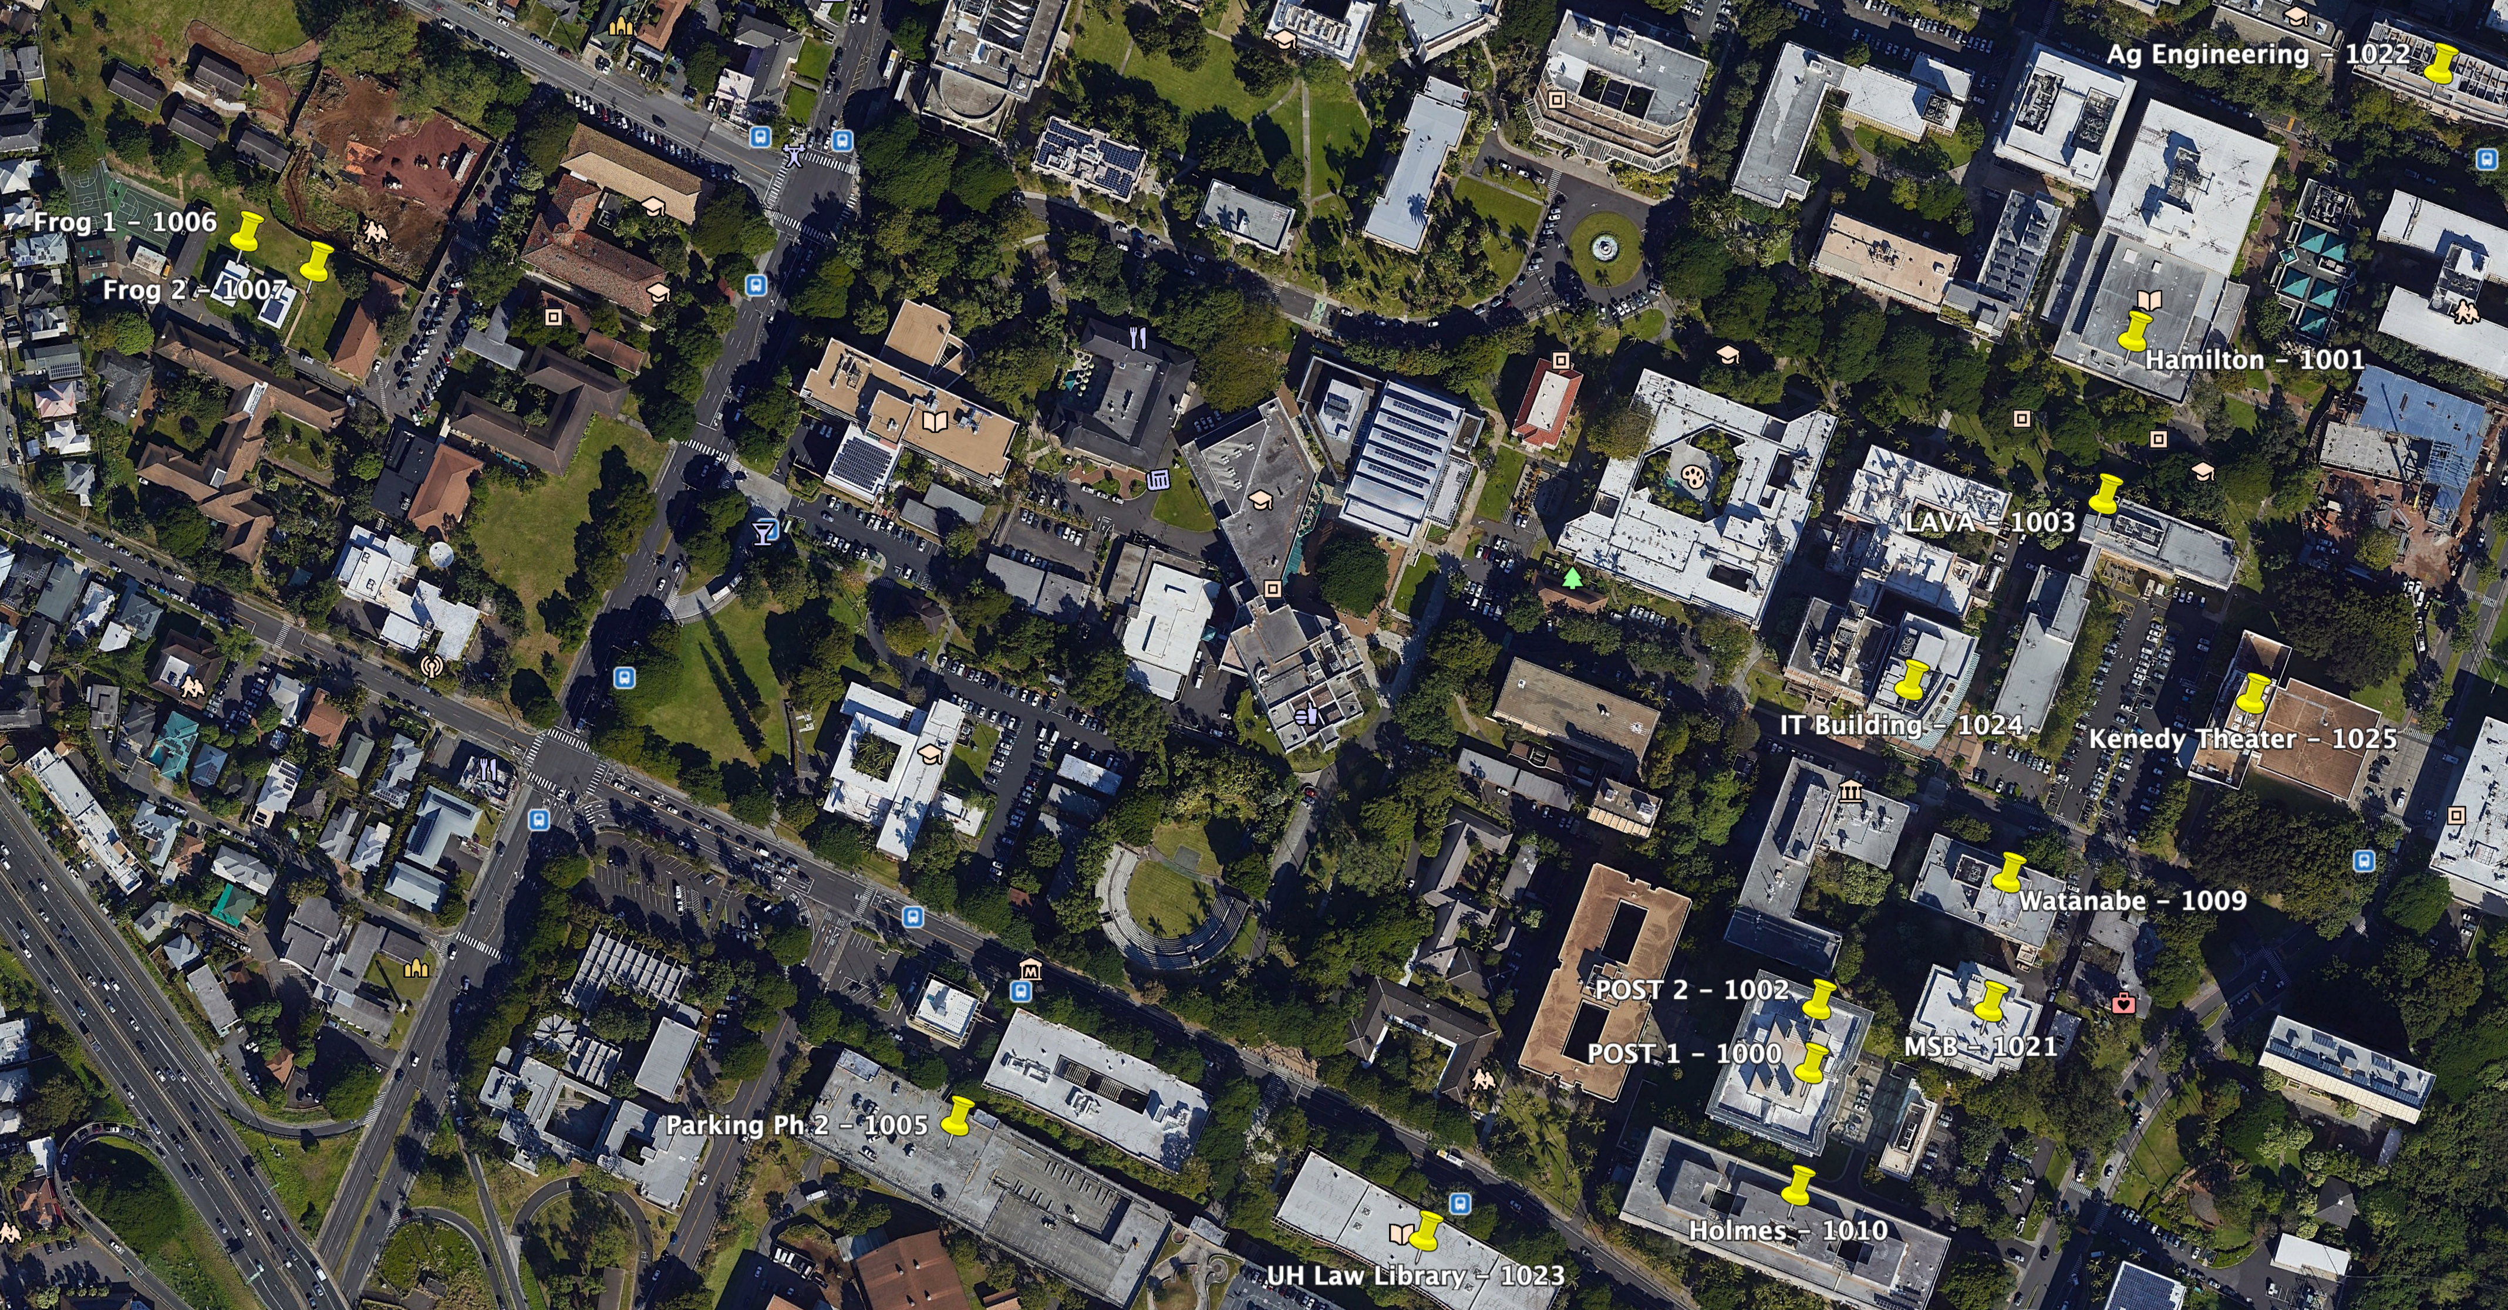
Contribution #2: Laha Evaluation
Deployment of two Laha-compatible DSNs
Validated data collection
Several experiments that test Laha’s major claims

Slide 8
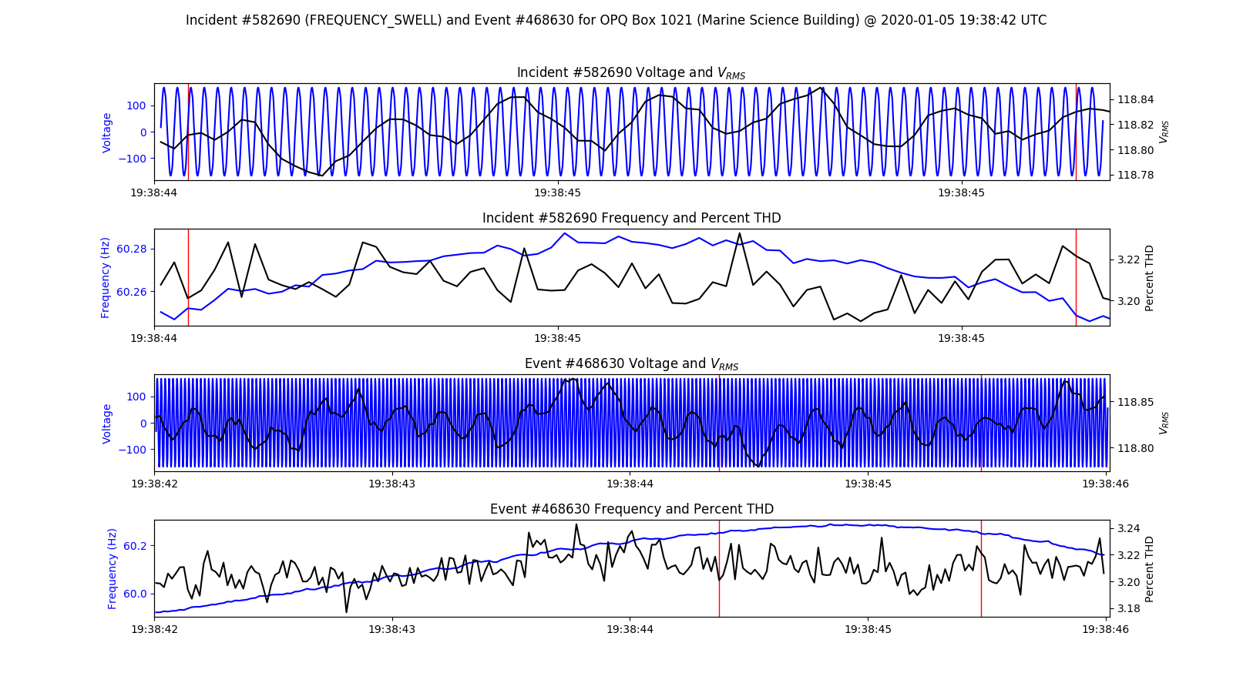
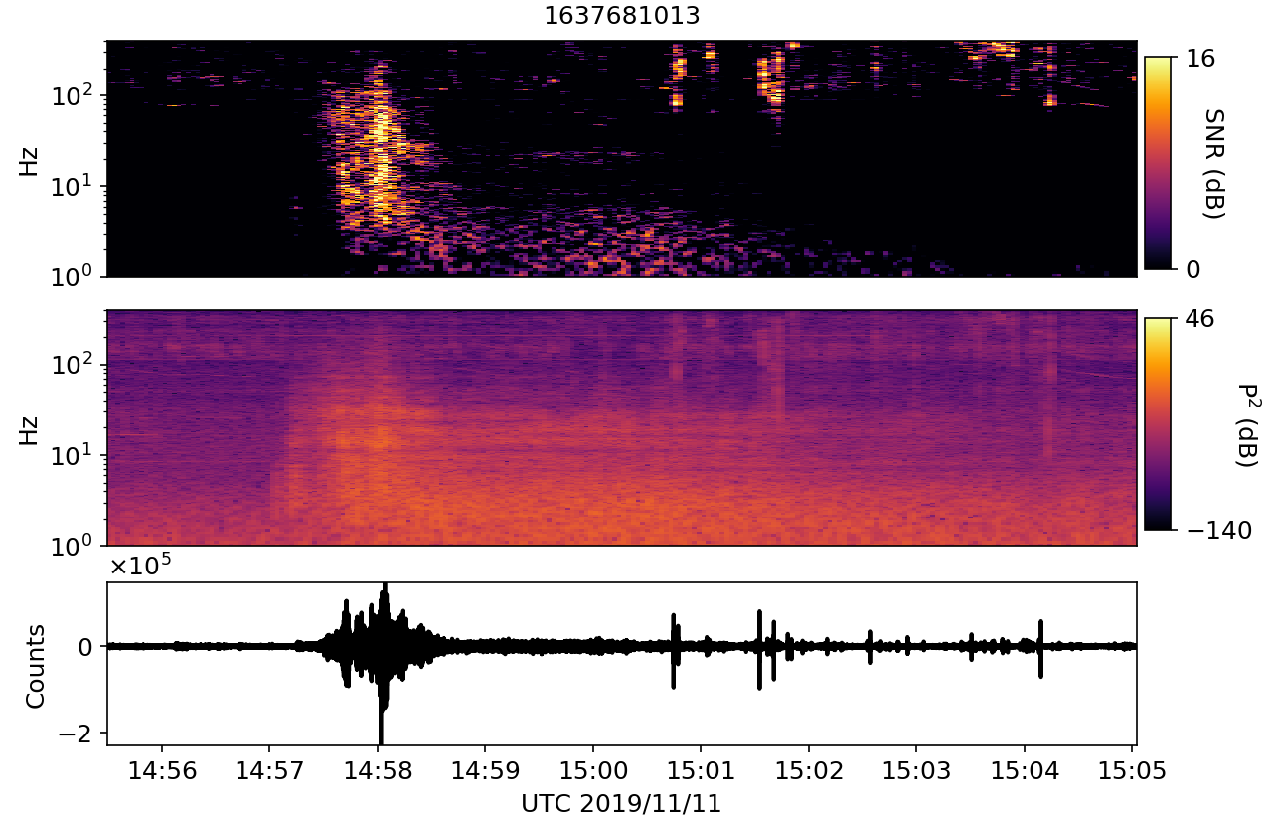
Contribution #3: Laha-compliant reference implementations
OpenPowerQuality (OPQ)
Distributed power quality (PQ) detection and analysis
Lokahi
Distributed infrasound detection and analysis

Slide 9
Contribution #4: Implications for modern DSNs
A set of implications for modern DSNs through the evaluation of Laha
Confirmation or denial of Laha’s benefits in relation to DSNs
Other domains that Laha is useful or not useful for
Source: CTBTO

Slide 10
Related work

Slide 11
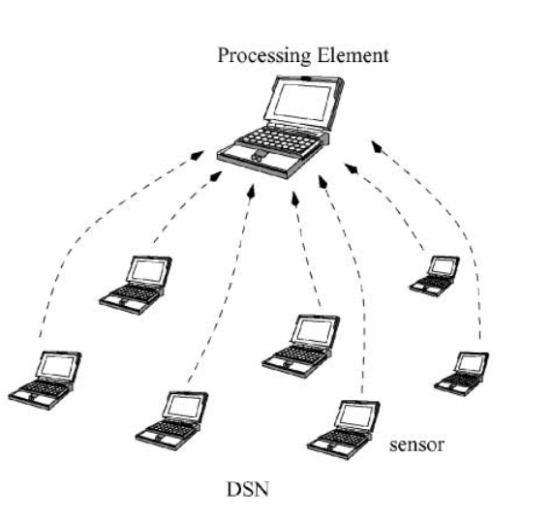
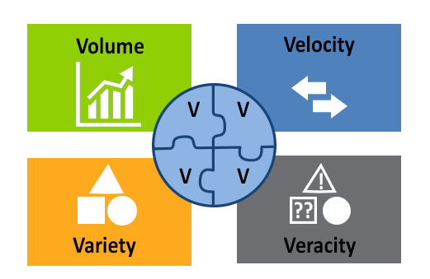
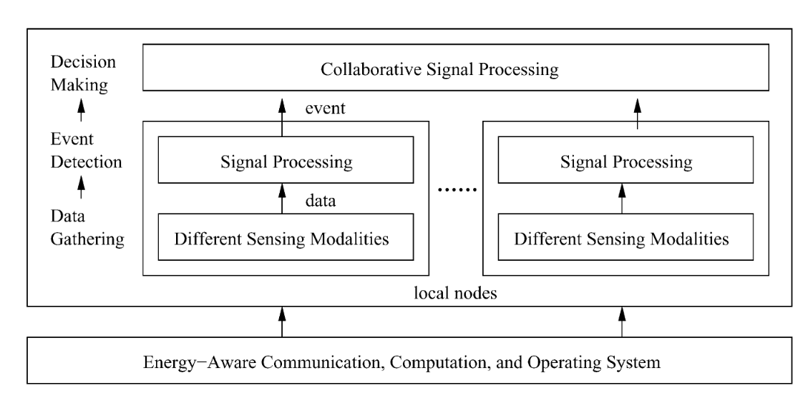
Big Data and Distributed Sensor Networks
REPORT TO THE PRESIDENT BIG DATA AND PRIVACY: A TECHNOLOGICAL PERSPECTIVE (PCAST 2016)
Undefined By Data: A Survey of Big Data Definitions (Ward et al 2013)
Distributed sensor networks -- review of recent research (Qi et al 2001)

Slide 12
Big data management for dsns

Slide 13
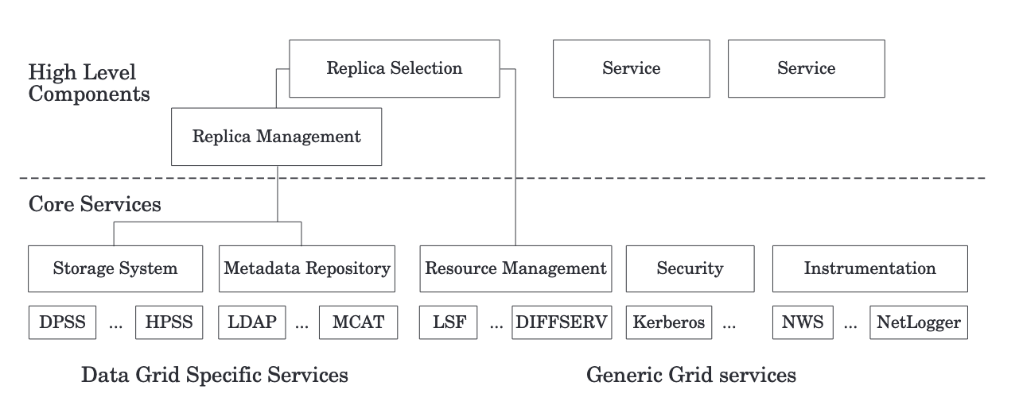
Data Grid (Chervenak et al 2000)
Notes:
* Model for management of storage of raw data and metadata

Slide 14
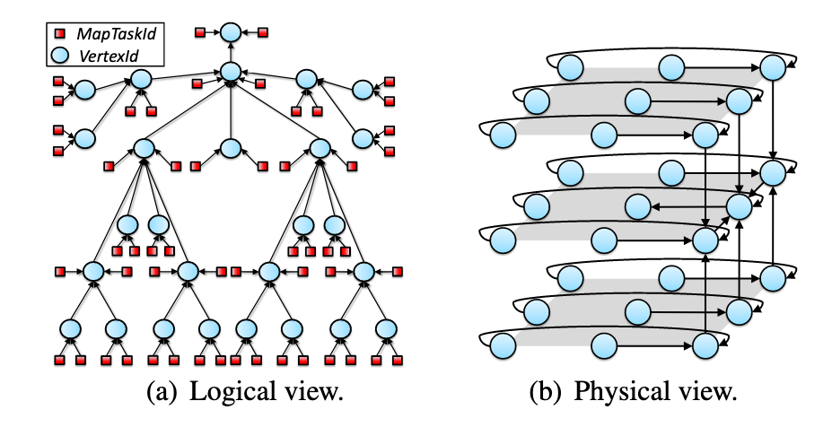
CAMDOOP (costa et al 2012)
Notes:
Aggregation at the edge
Data reduction but keep semantic meaning
Only used on simple features (word counts)
Only simulated

Slide 15
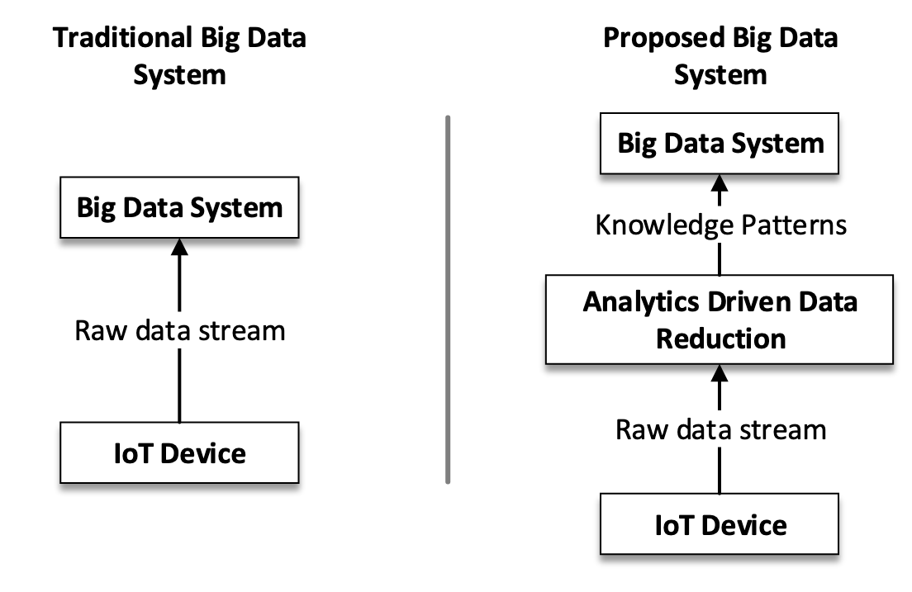
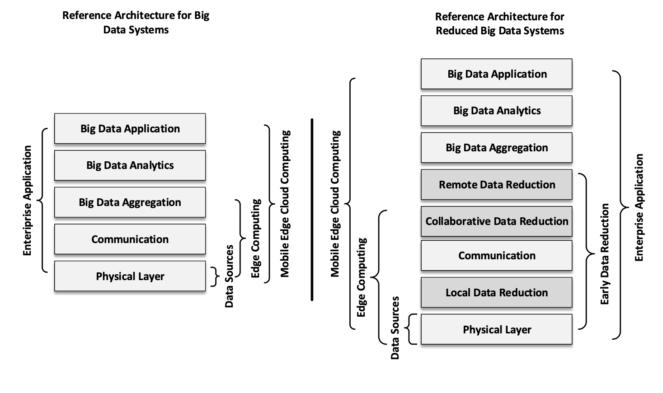
Big Data reduction framework (REHMAN et al 2016)
Notes:
Reducing data early leads to efficient value proposition
Mainly focuses on enterprise data
Reduction provides lowered costs, increased privacy, enhance trust between users and developers

Slide 16
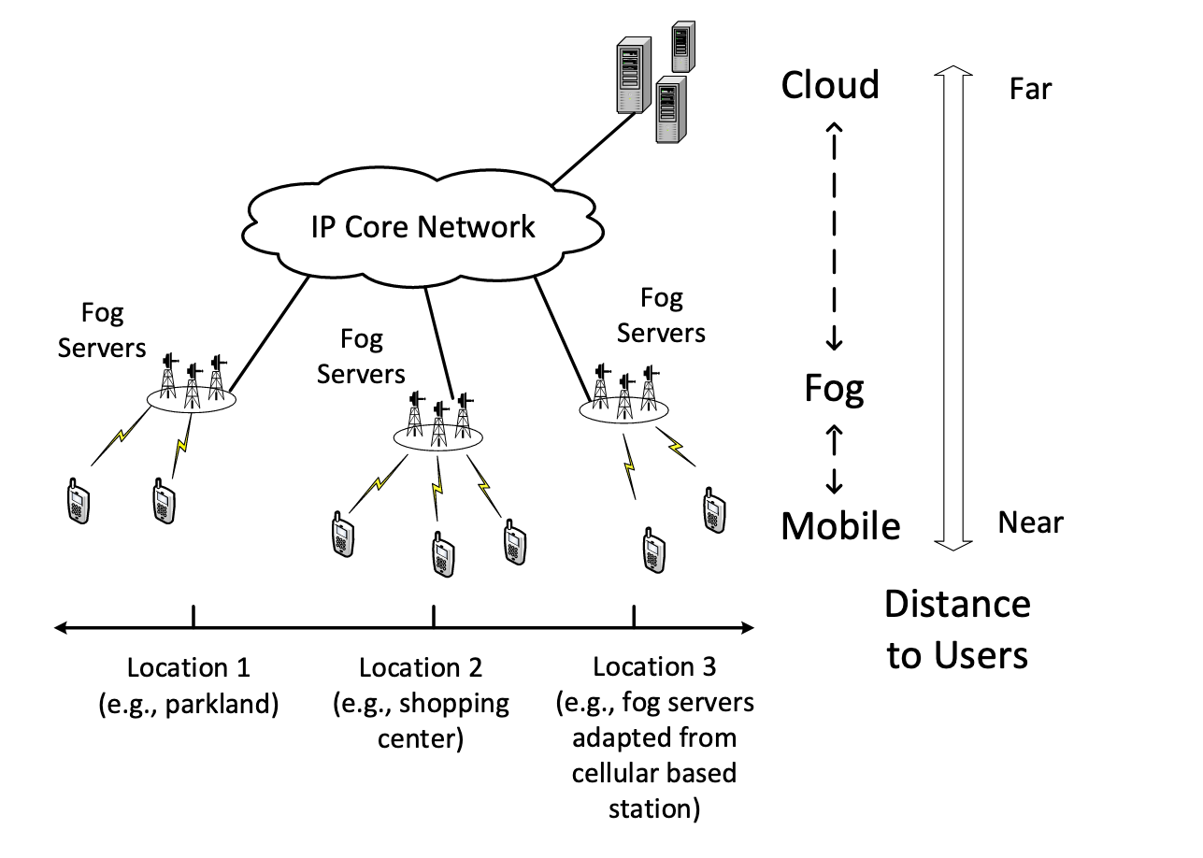
Fog Computing: Focusing on Mobile Users at the Edge (luan et al 2015)
Notes:
Perform computations at the edge on on servers near the edge
Problems with deploying enough resources towards the edge when density increases

Slide 17
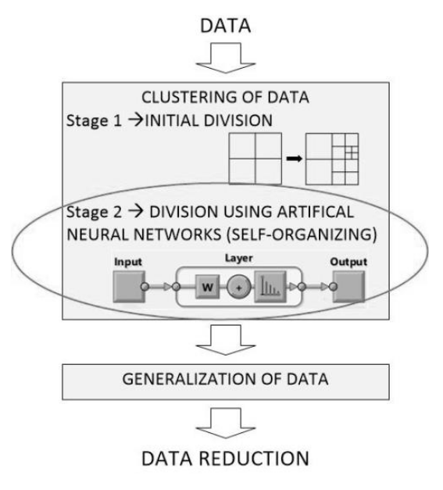
Self-organizing Artificial Neural Networks into Hydrographic Big Data Reduction Process (Stateczny et al 2014)
Notes:
* hydrographic sonar data
Issues with dense data
Very domain specific

Slide 18
Predictive analytics and forecasting for dsns

Slide 19
Energy conservation in wireless sensor networks: A survey (anastasi et al 2009)
Notes:
Provide three approaches for data prediction
Stochastic uses statistics to predict If given data falls within a model
TSF uses historical data to predict future data (LR and other means)

Slide 20
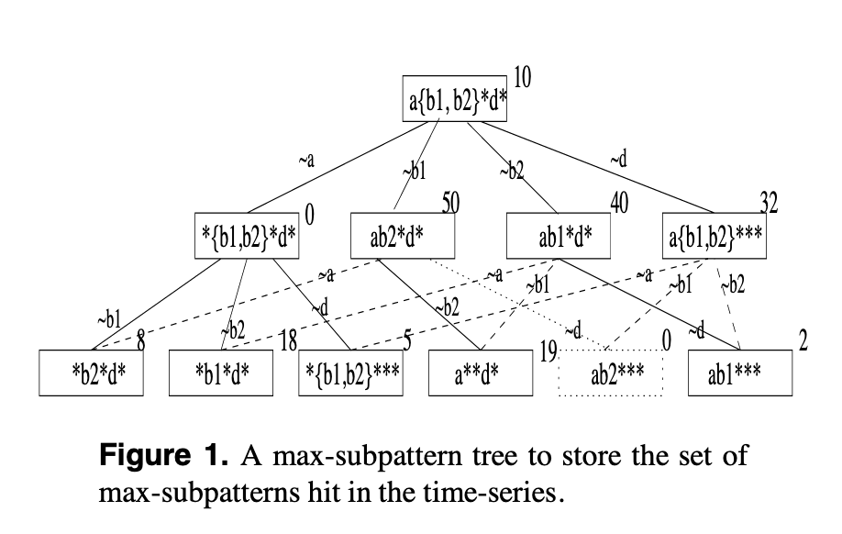
Efficient Mining of Partial Periodic Patterns in Time Series Database (HAN et al 1999)
Notes:
Detection of partial periodic signals through a max-subpattern tree
O(N^2)

Slide 21
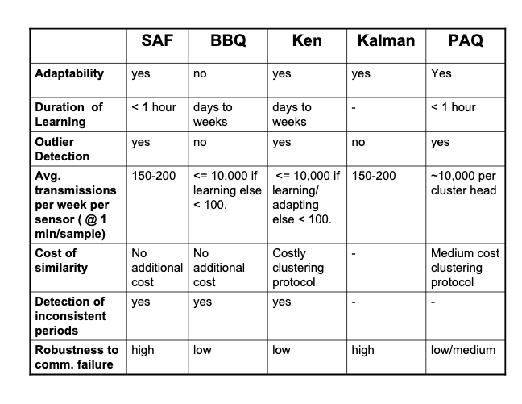
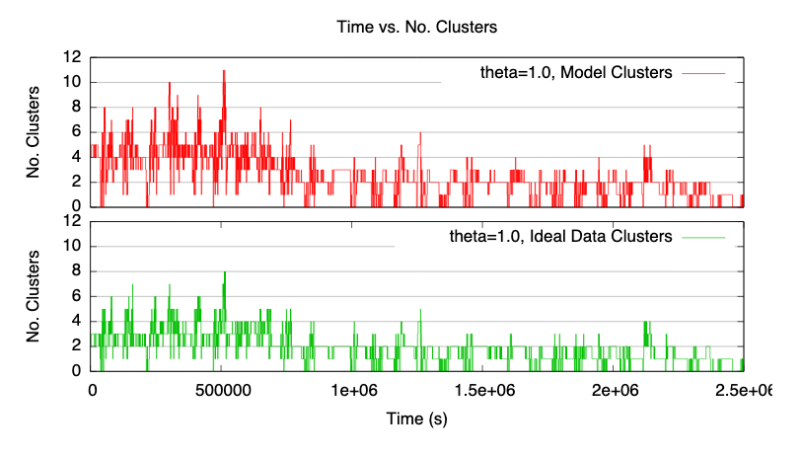
An Energy-efficient Querying Framework In SensorNetworks For Detecting Node Similarities (TULONE et al 2006)
Notes:
* Improves on PAG model (LR) by adding clustering

Slide 22
Topology and localization

Slide 23
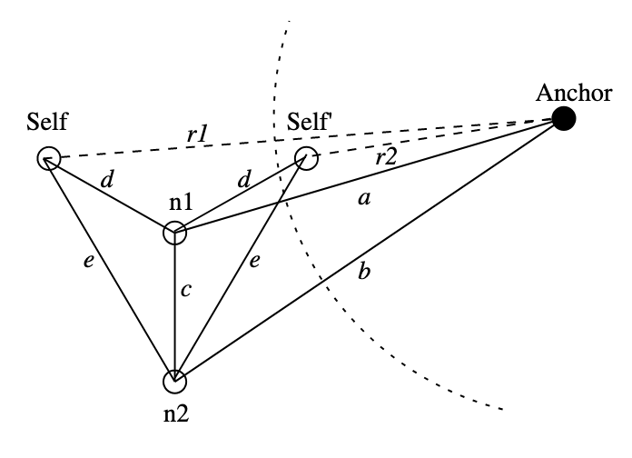
Distributed localization in wireless sensor networks: a quantitative comparison (langendoen et al 2003)
Notes:
Statistics from multiple sensors to determine localization
Does not work with ad-hoc sensors

Slide 24
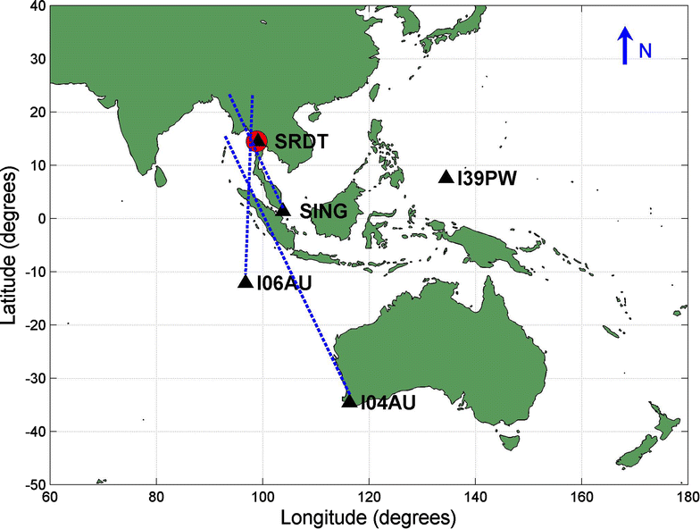
Infrasound and seismic detections associated with the 7 September 2015 Bangkok fireball (Caudron et al 2016)

Slide 25
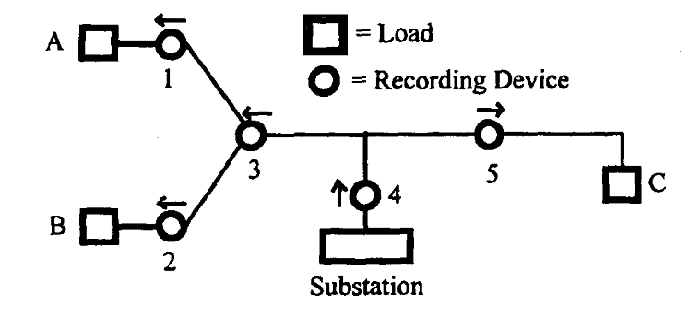
A Direction Finder for Power Quality Disturbances Based Upon Disturbance Power and Energy (PARSONS et al 1998)
Notes:
Localize PQ disturbances by analyzing flow through grid of voltage sags
May be too simplified for real grids

Slide 26
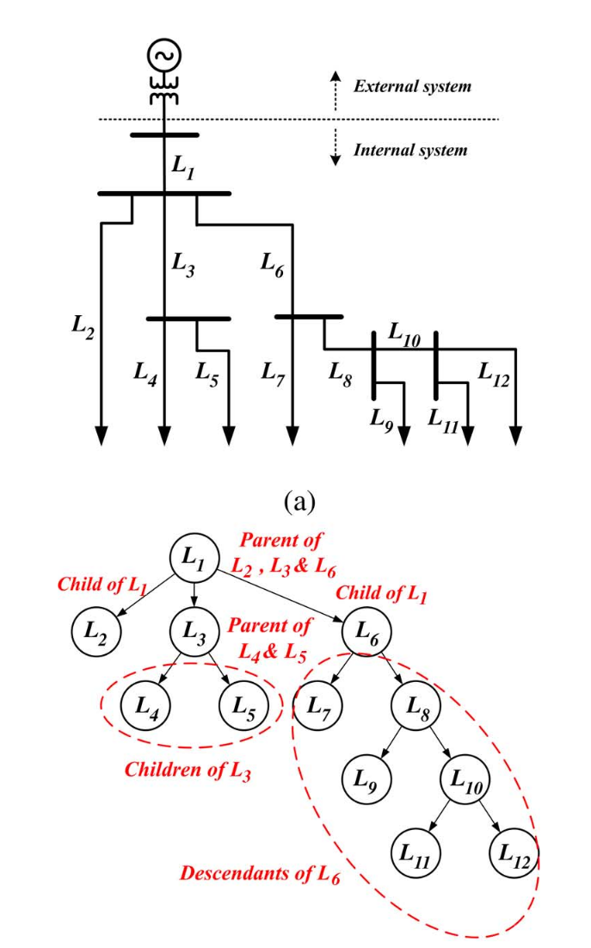
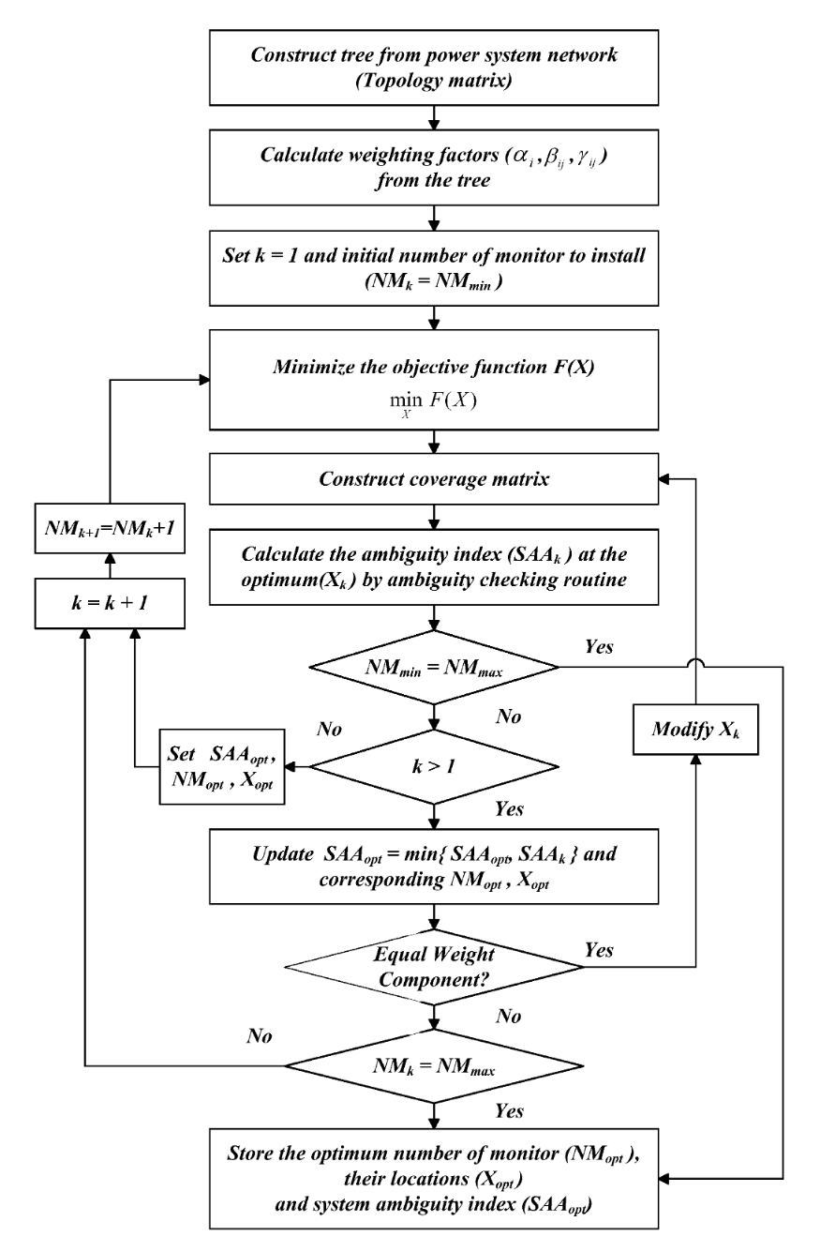
Optimal Number and Locations of Power Quality Monitors Considering System Topology (won et al 2008)
Notes:
Maximizes signal collection by minimizing sensors
Optimal placement of PQ sensors on a grid

Slide 27
Optimizations for triggering

Slide 28
Wireless integrated network sensors (pottie et al 2000)
Notes:
* Duty cycle sensors based on there topology to save energy

Slide 29
An Adaptive Sampling Algorithm for Effective Energy Management in Wireless Sensor Networks With Energy-Hungry Sensors (Alippi et al 2010)
Notes:
Compressed sensing based on topology of sensors

Slide 30
topology Control in Wireless Ad Hoc and Sensor Networks (SANti 2005)

Slide 31
Laha design: converting primitive data into actionable insights & sensor big data management

Slide 32
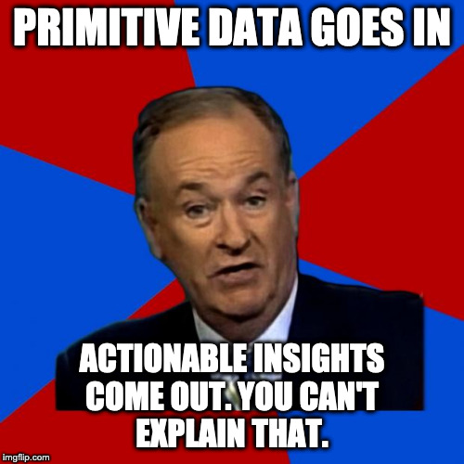

Slide 33
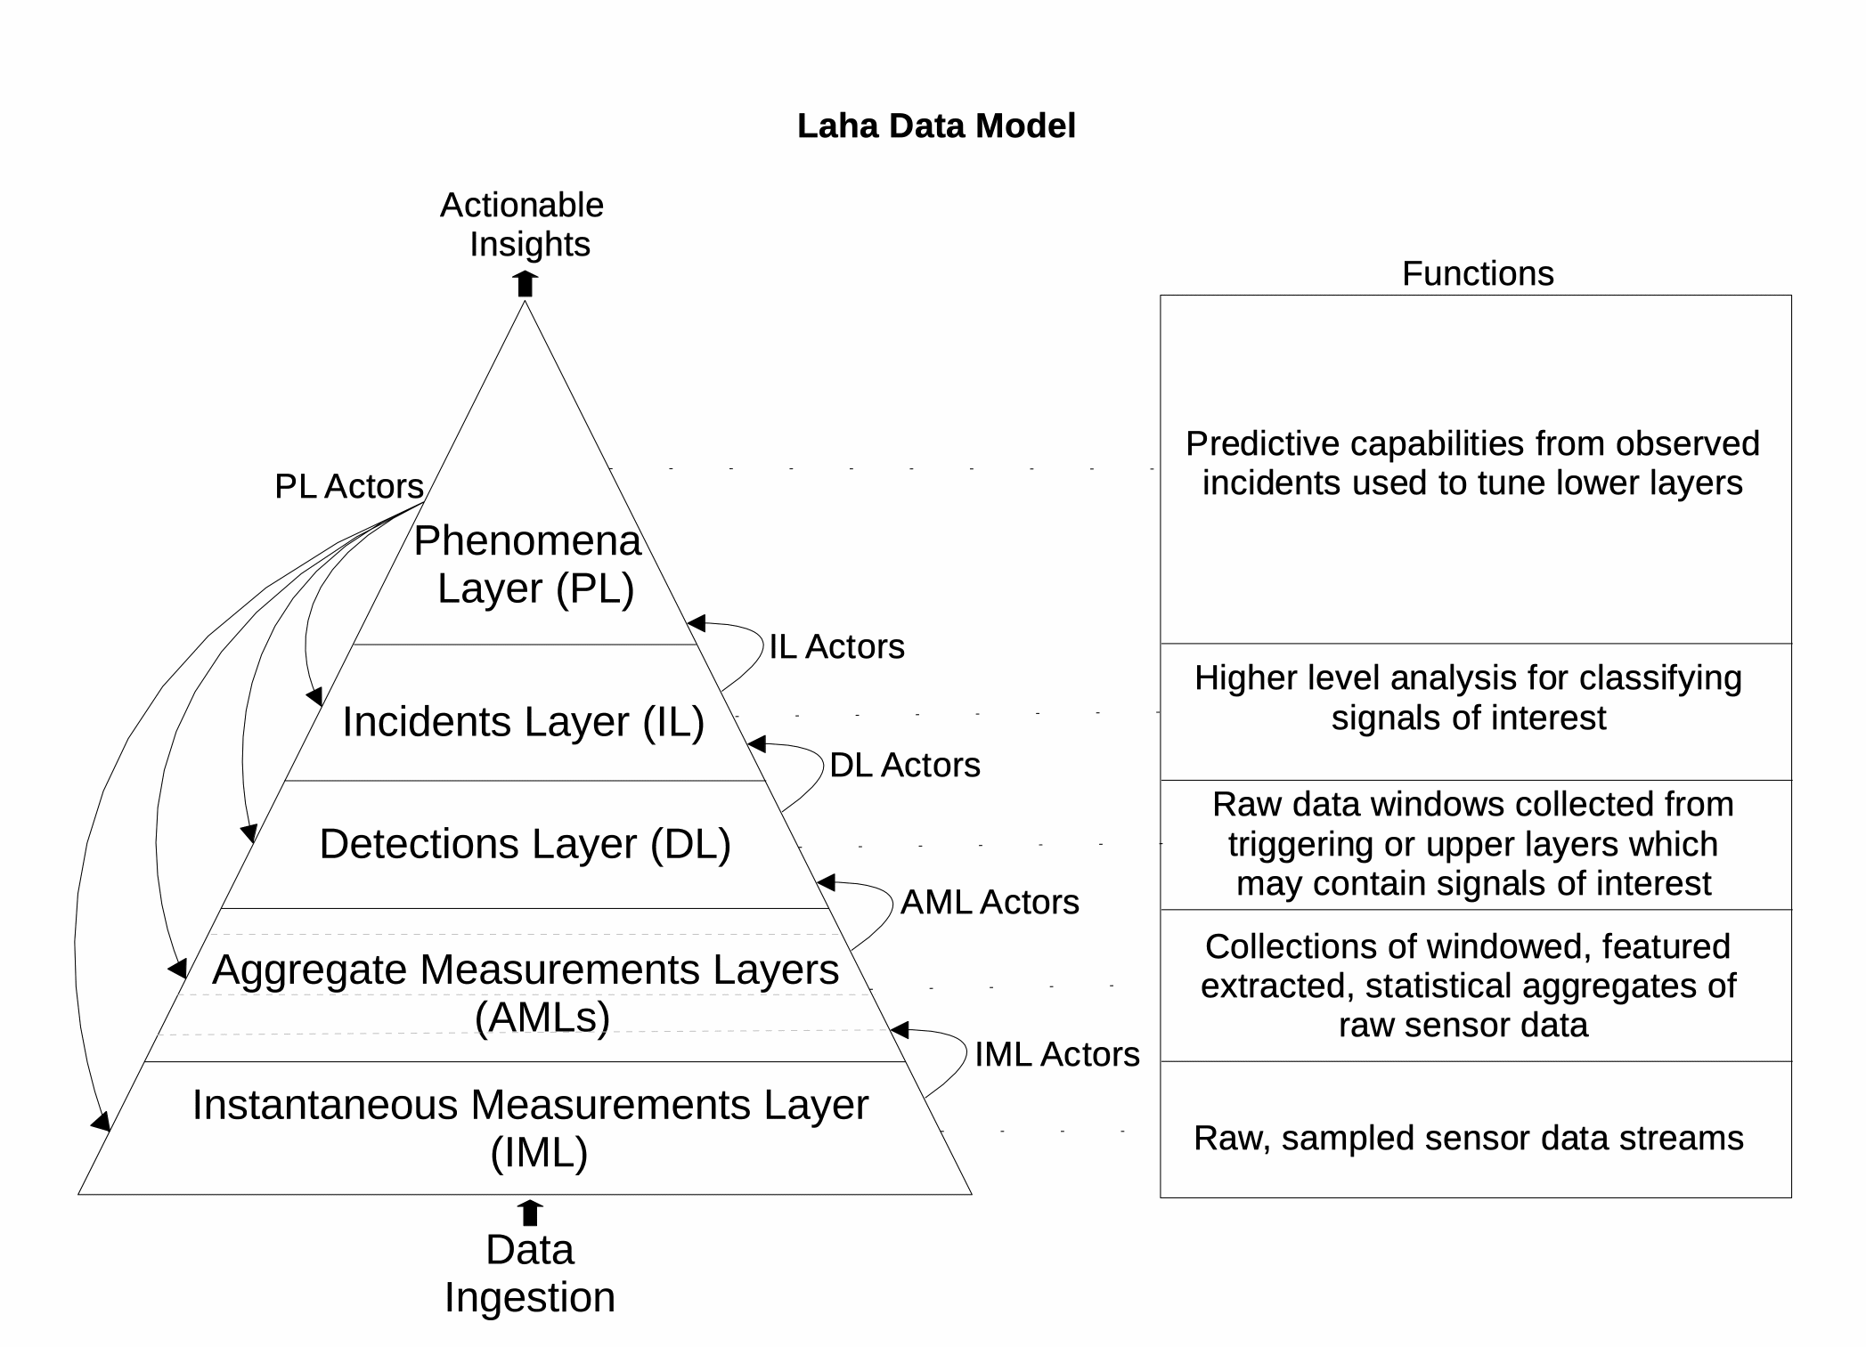
Design: Laha
Primitive data goes in
Actionable insights come out

Slide 34
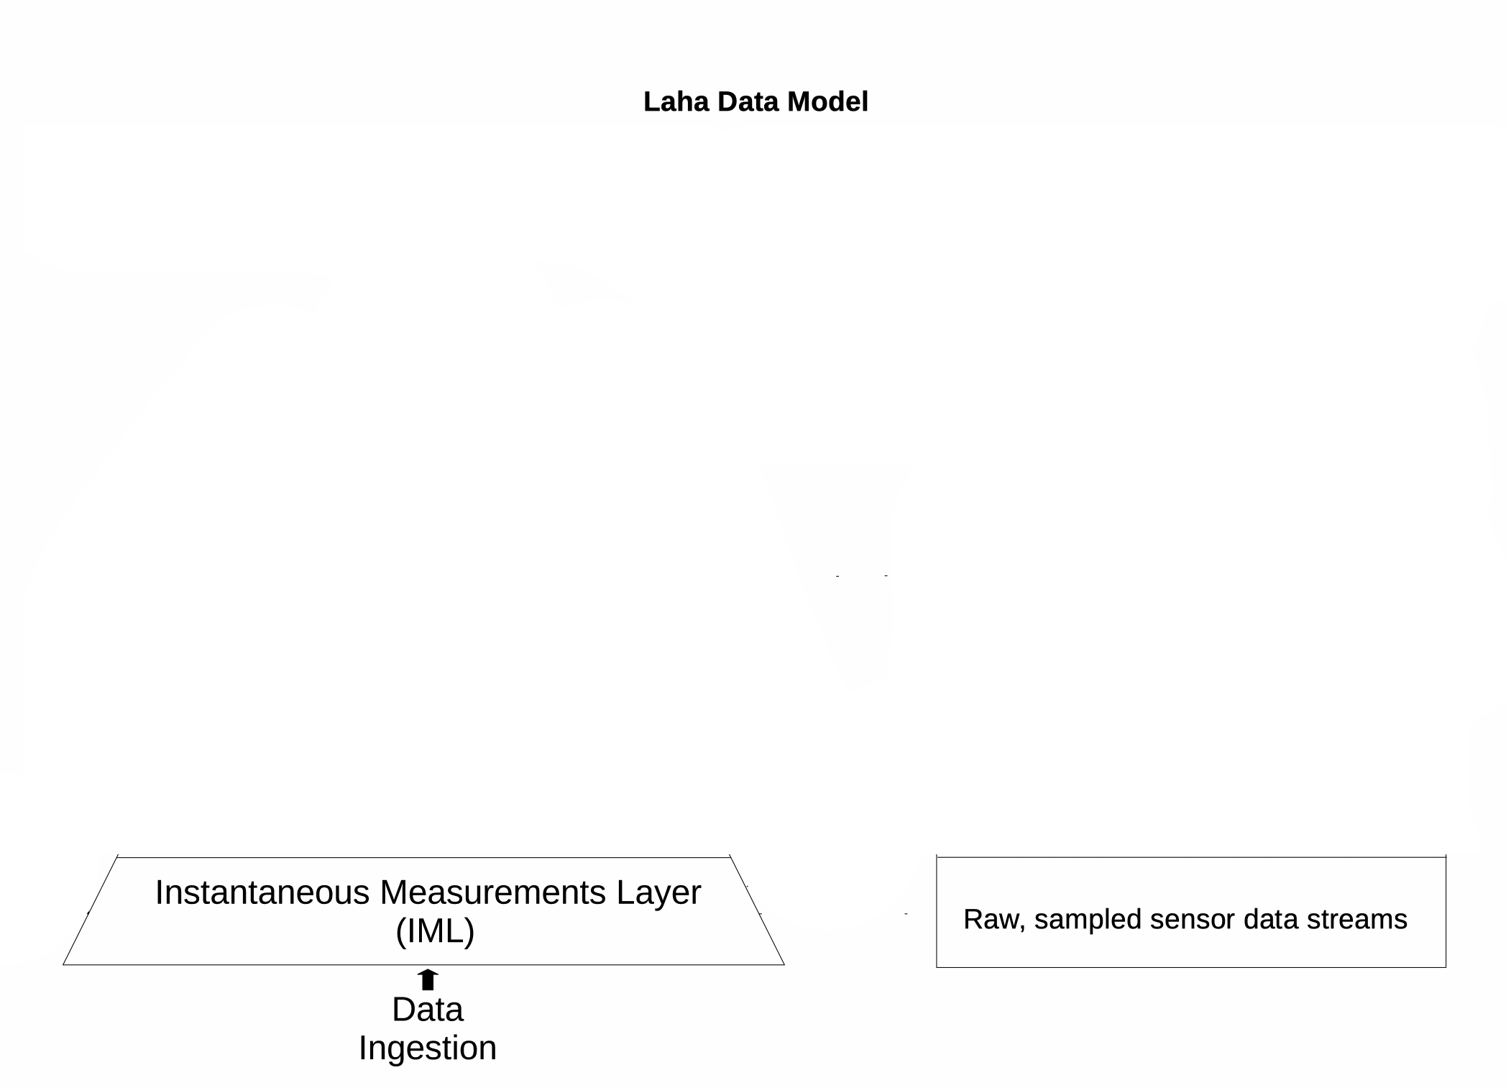
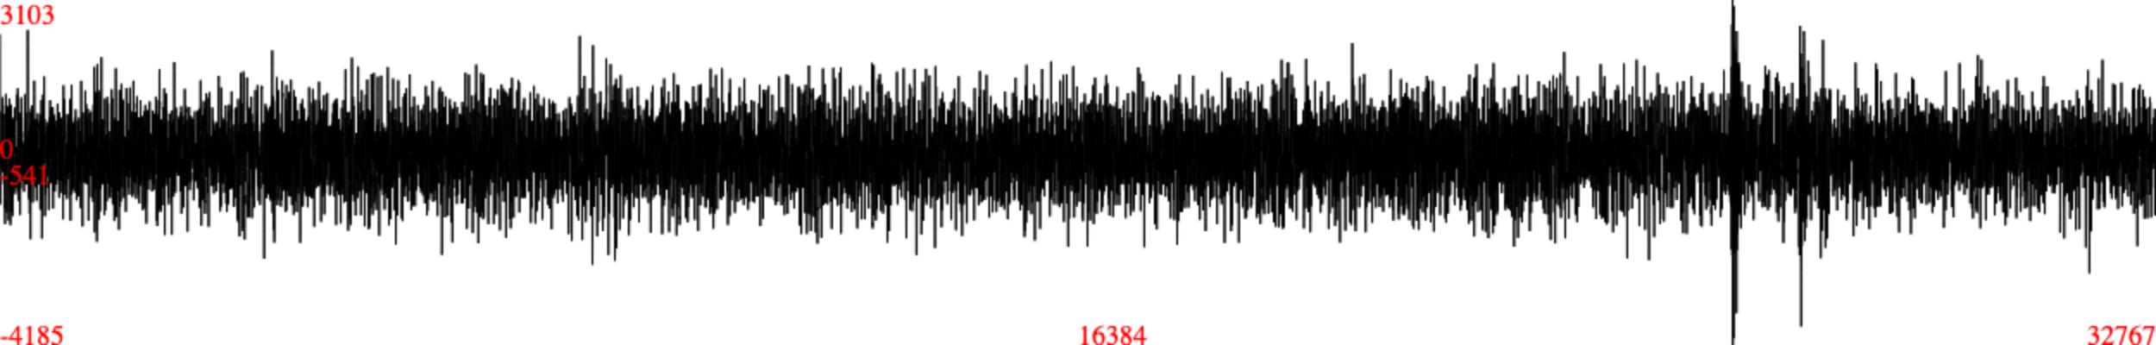
Design: LAHA IML
Raw Sensor Samples
TTL
15 Minutes

Slide 35
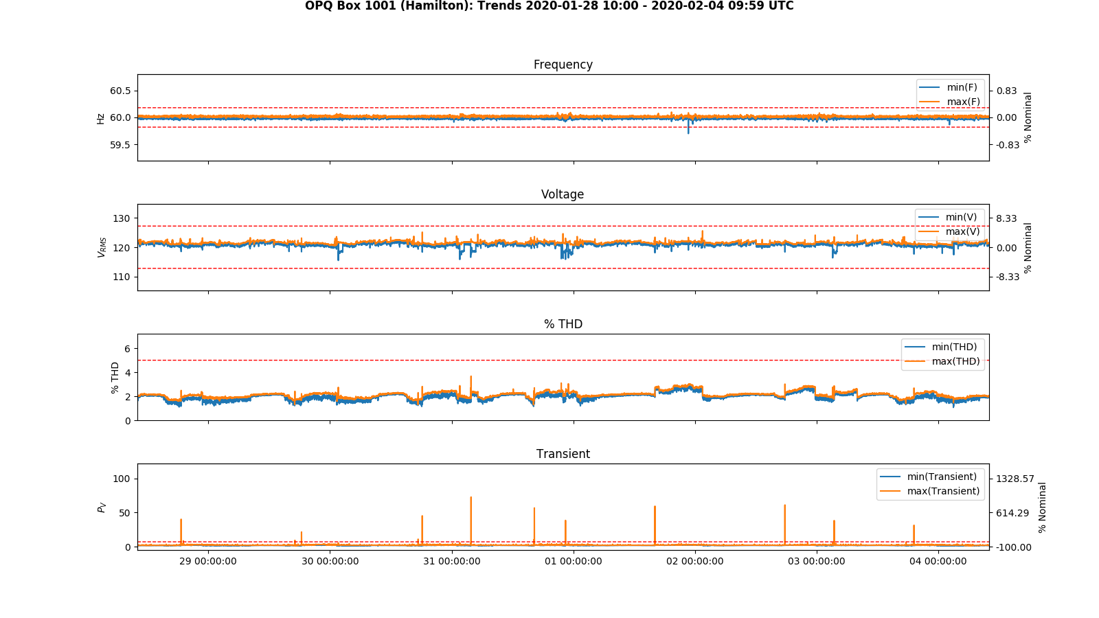
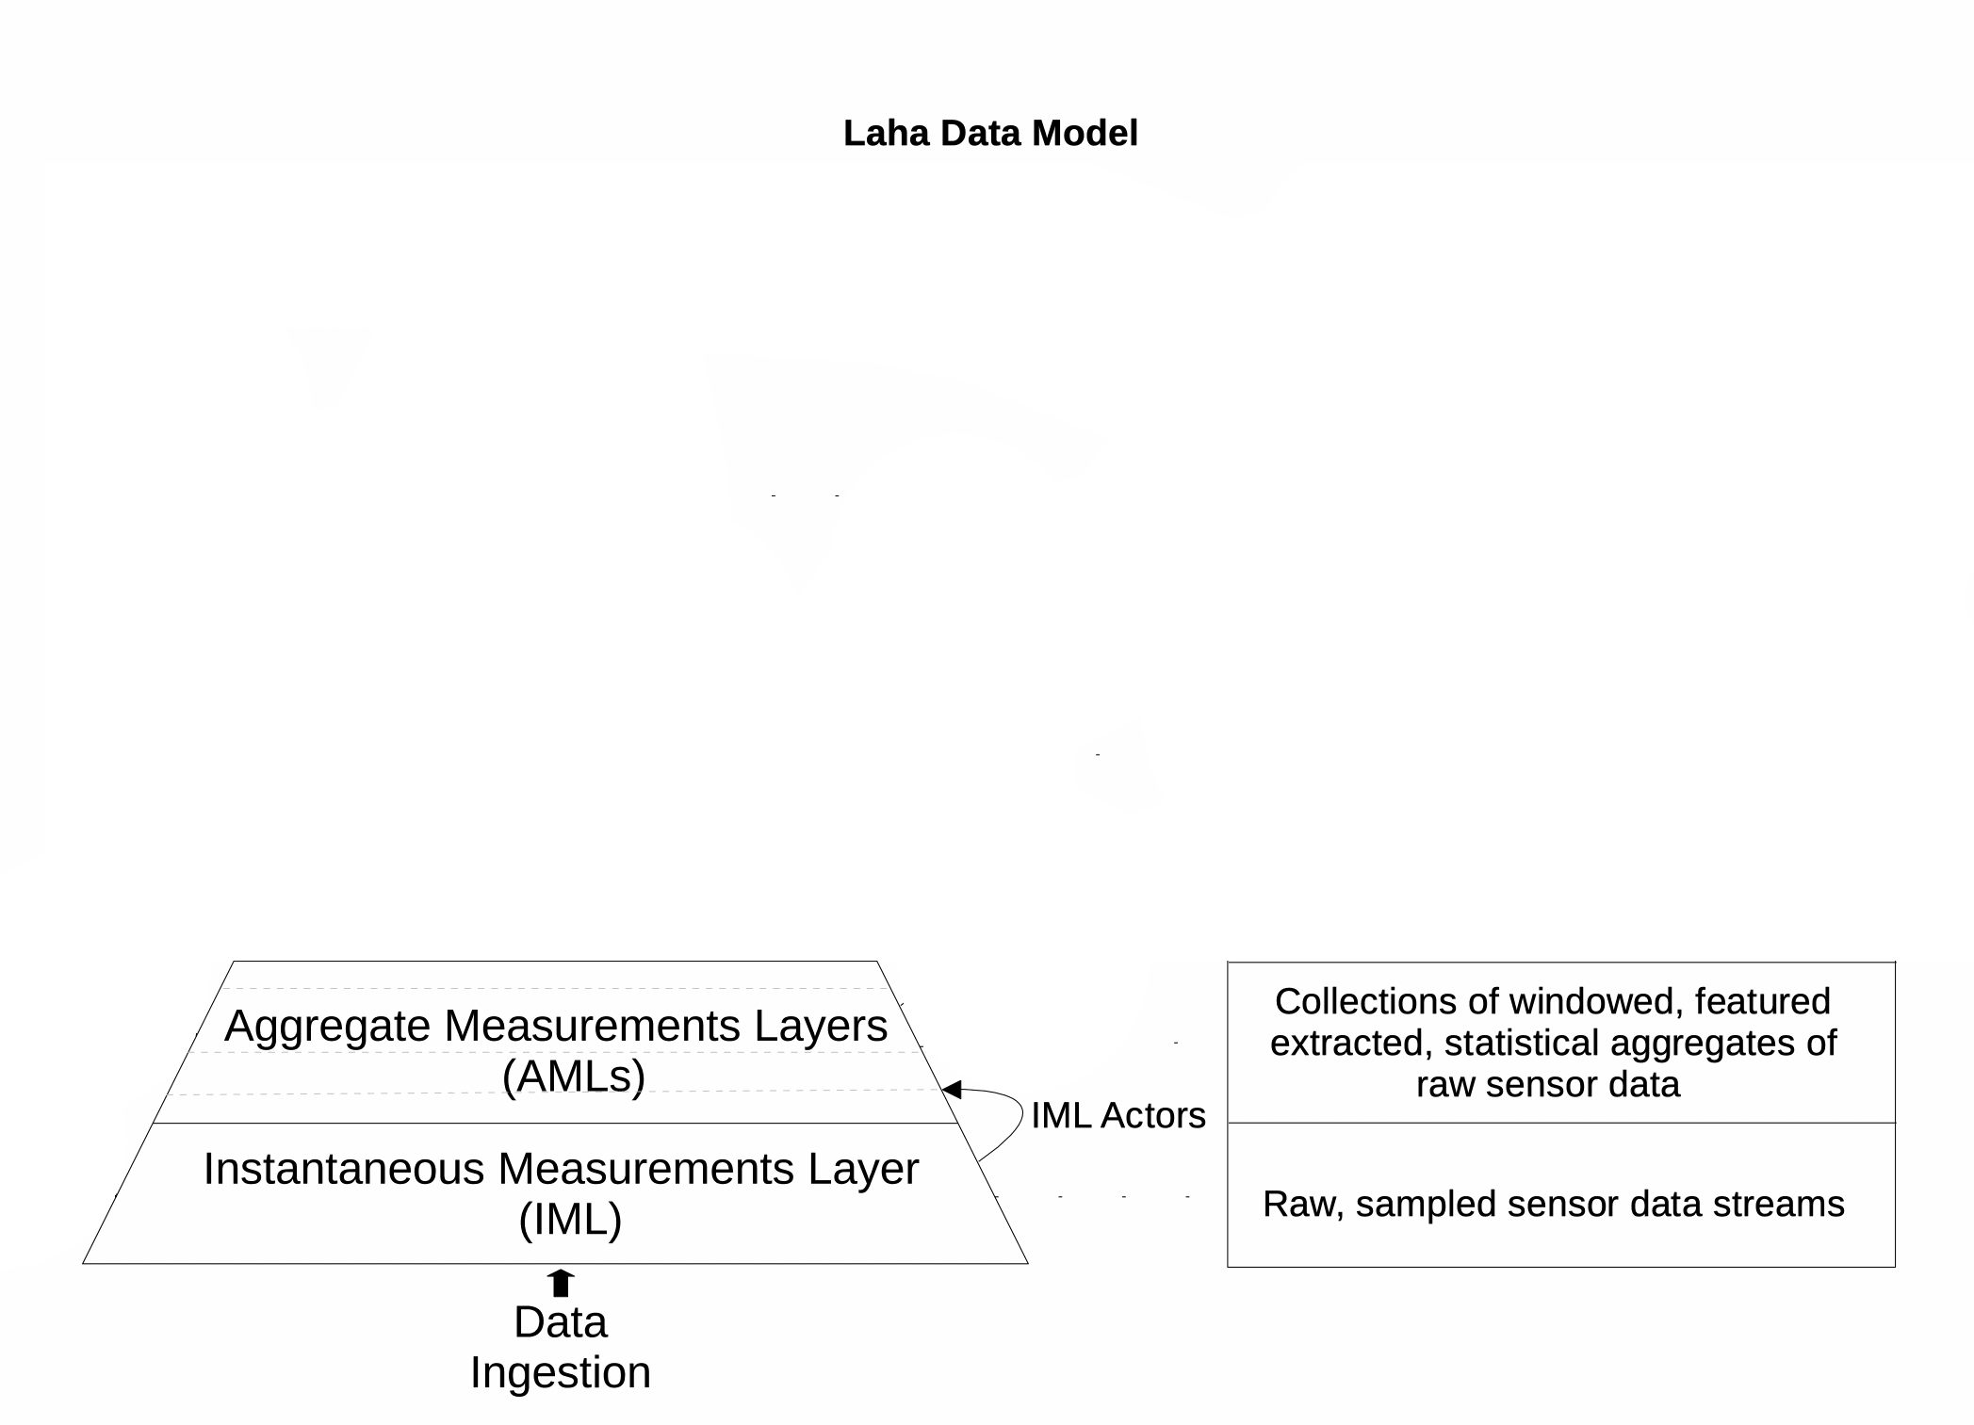
Design: LAHA AML
Summary statistics of extracted features
TTL
24 Hours
2 Weeks

Slide 36
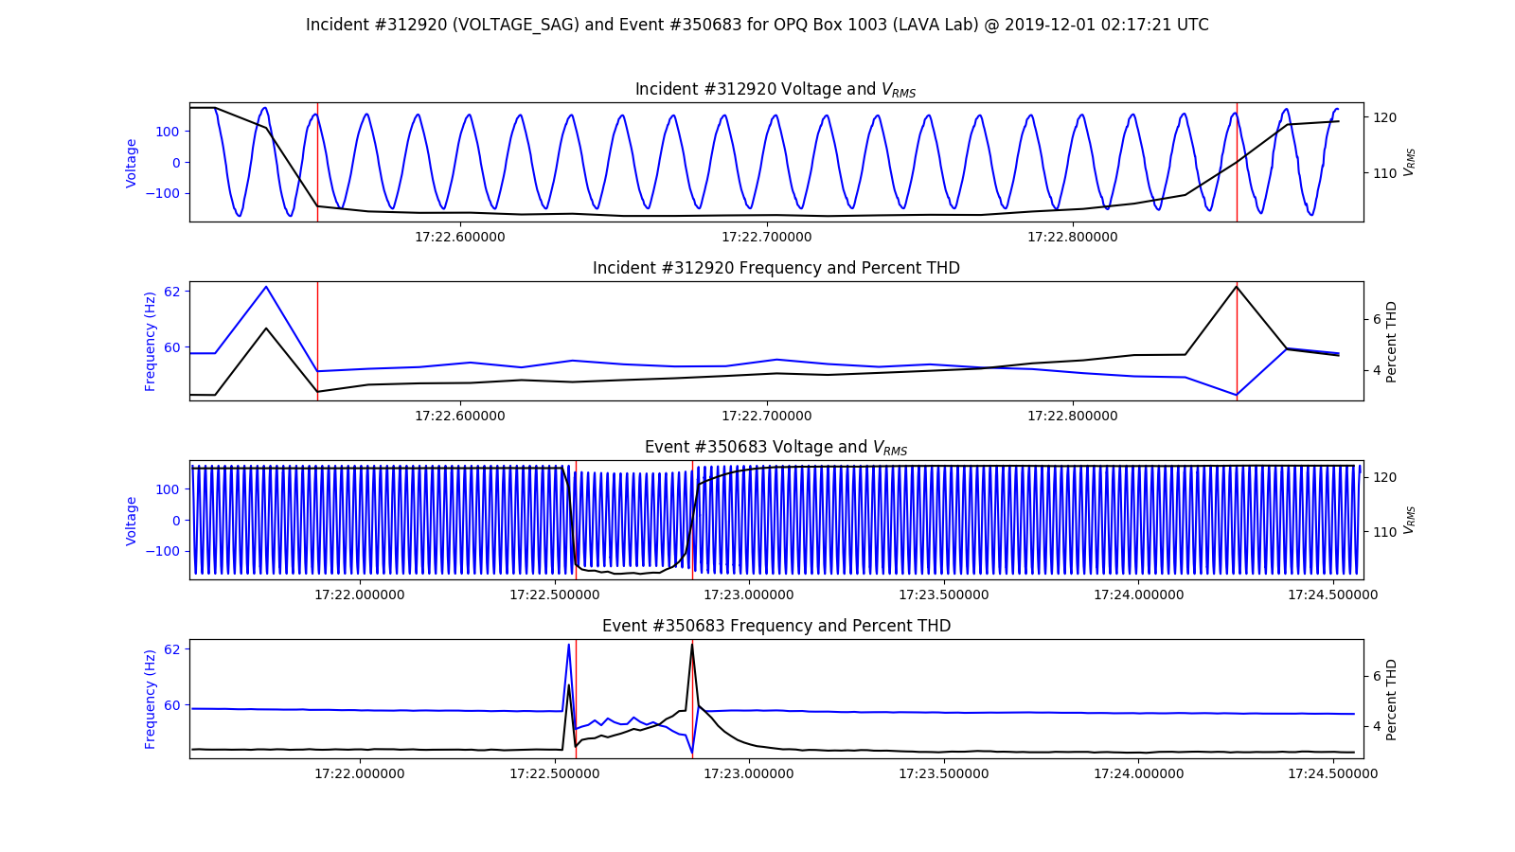
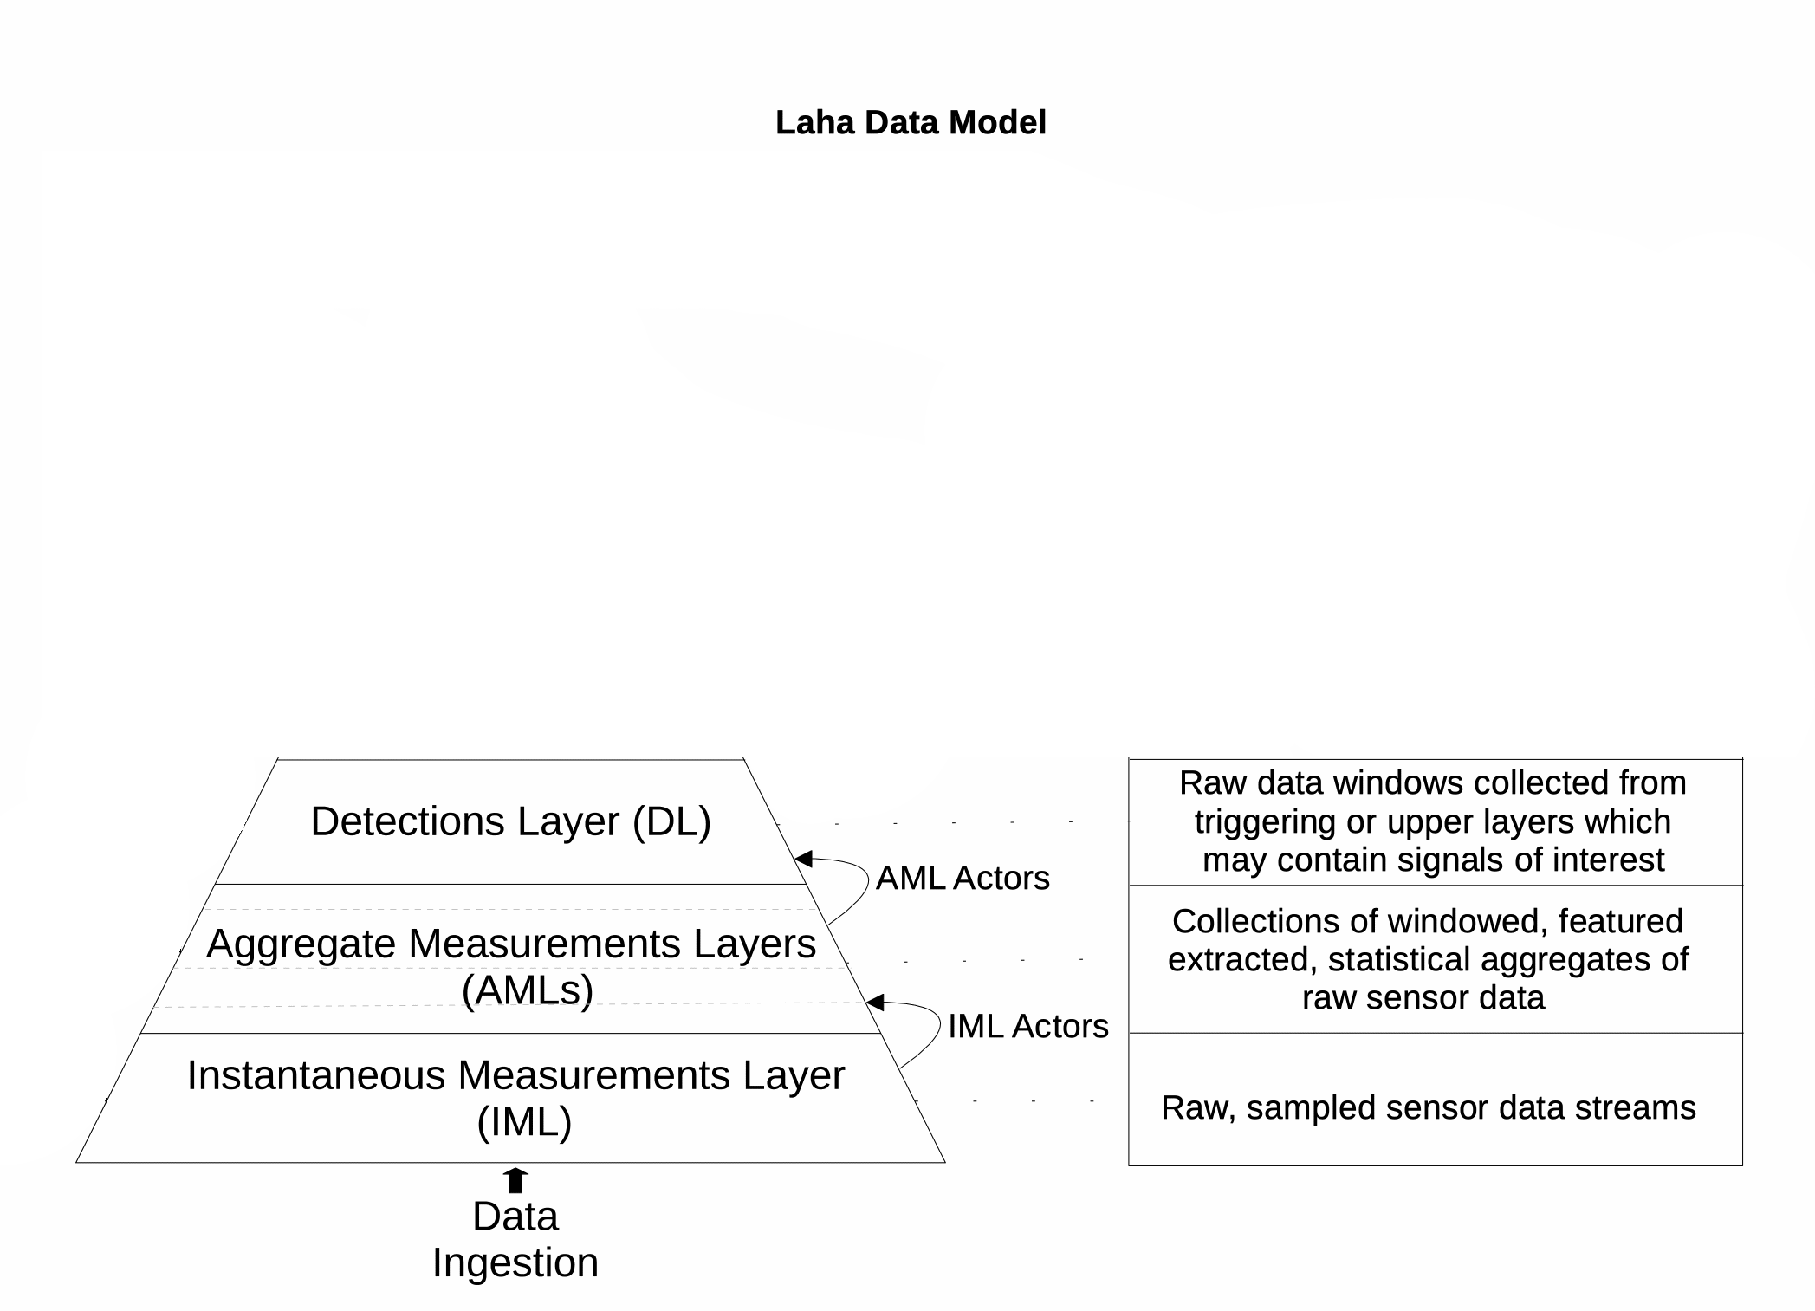
Design: LAHA DL
Window containing potential signals of interest
TTL
1 Month

Slide 37
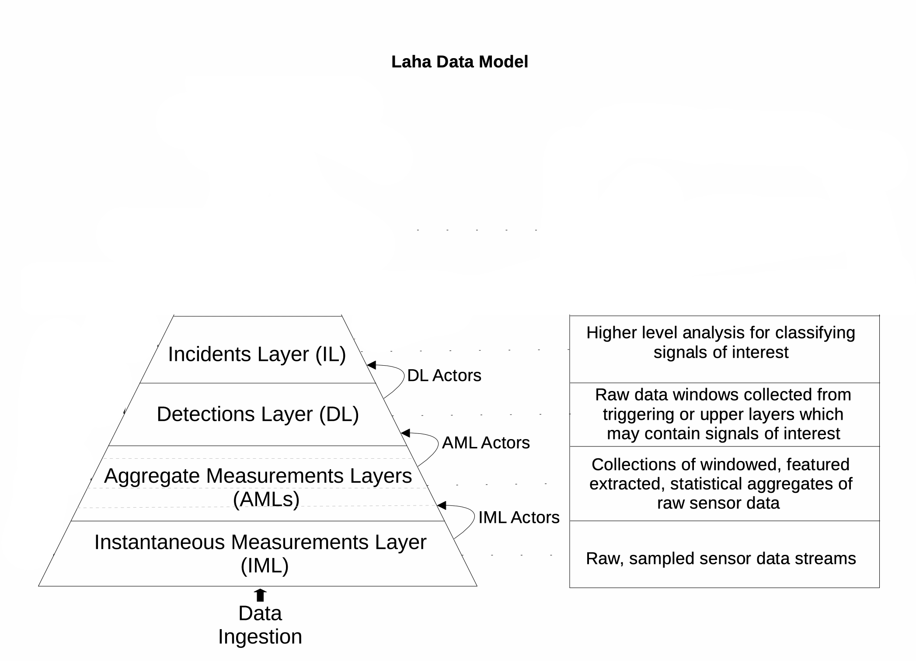
Design: LAHA IL
Window containing classified signals of interest
TTL
1 Year

Slide 38
Design: Laha PL
Actional insights
Predictive analytics
Data grouping
TTL
2 Years

Slide 39
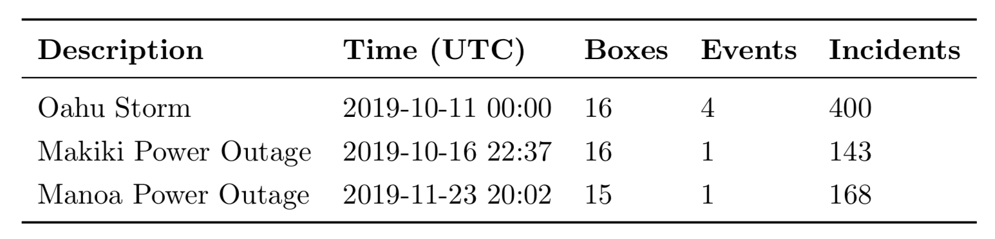
DESIGN: ANNOTATION PHENOMENA

Slide 40
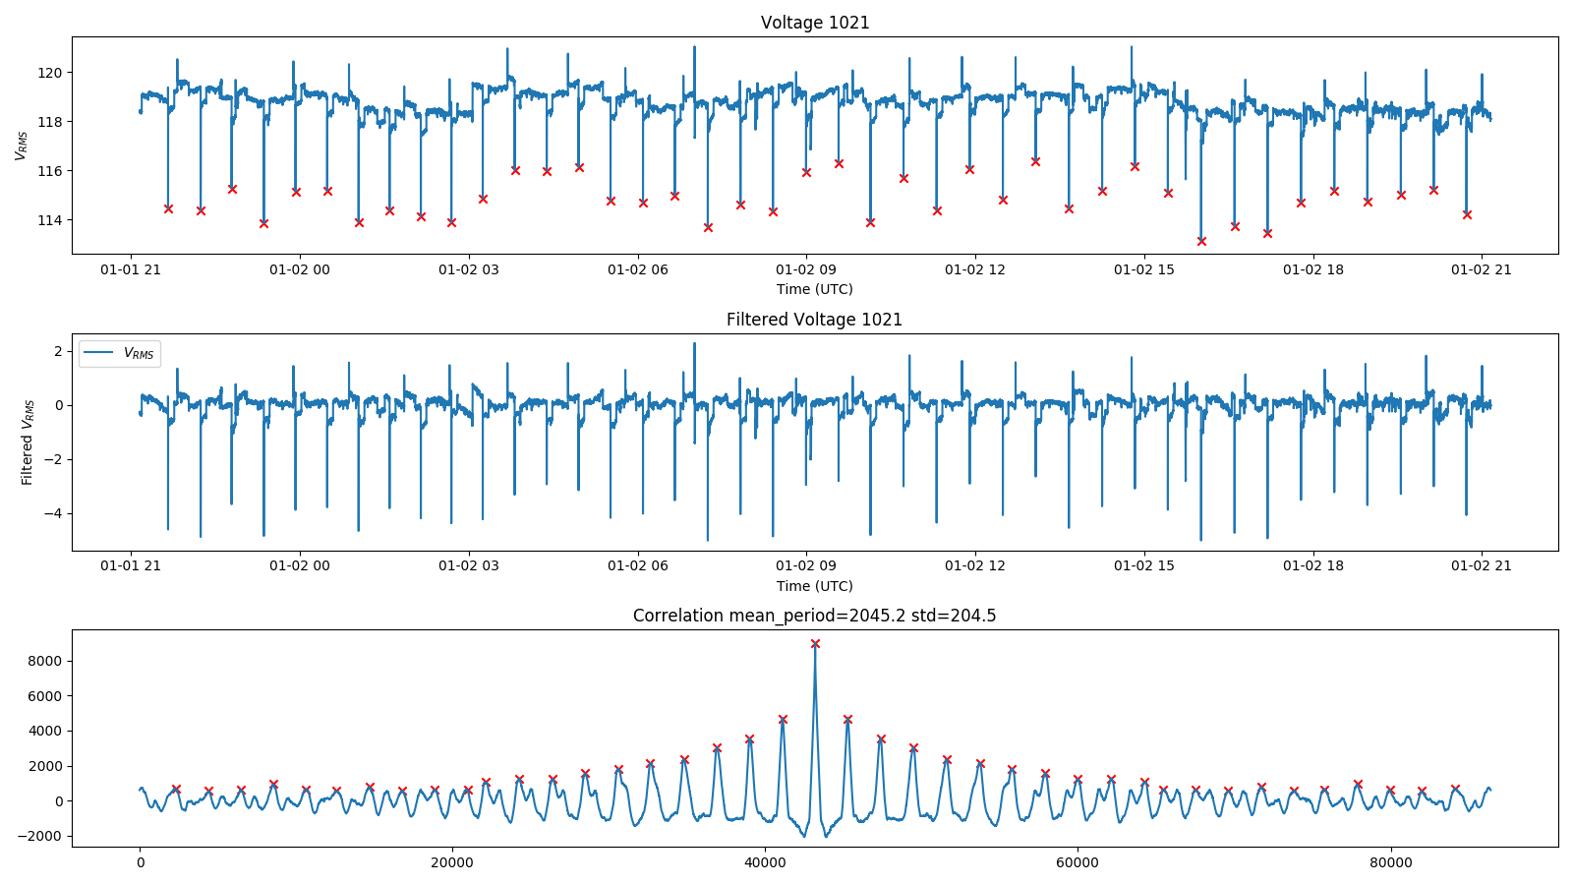
DESIGN: periodic PHENOMENA

Slide 41
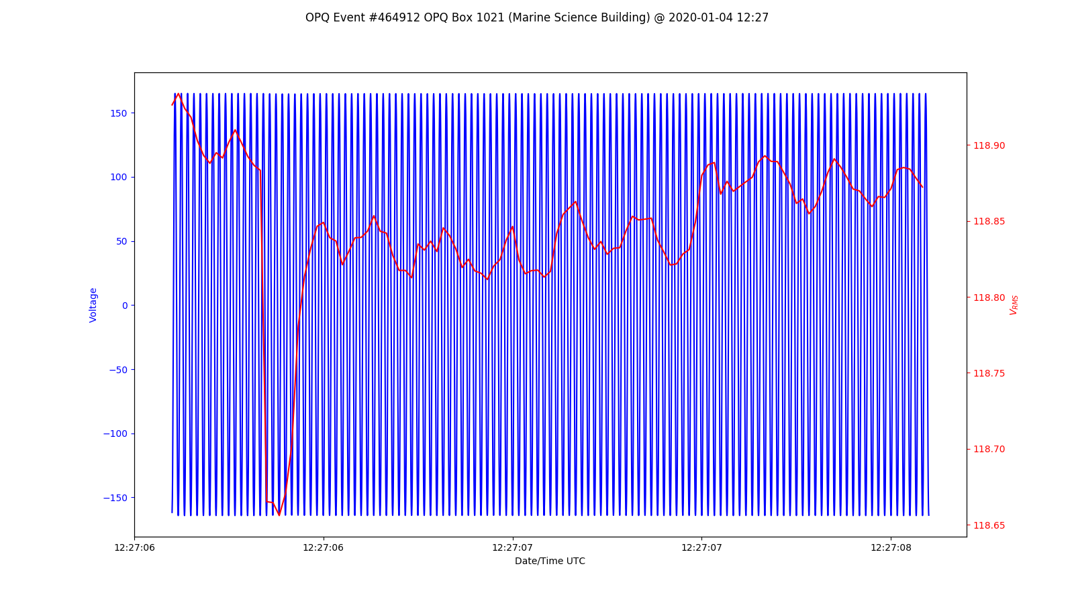
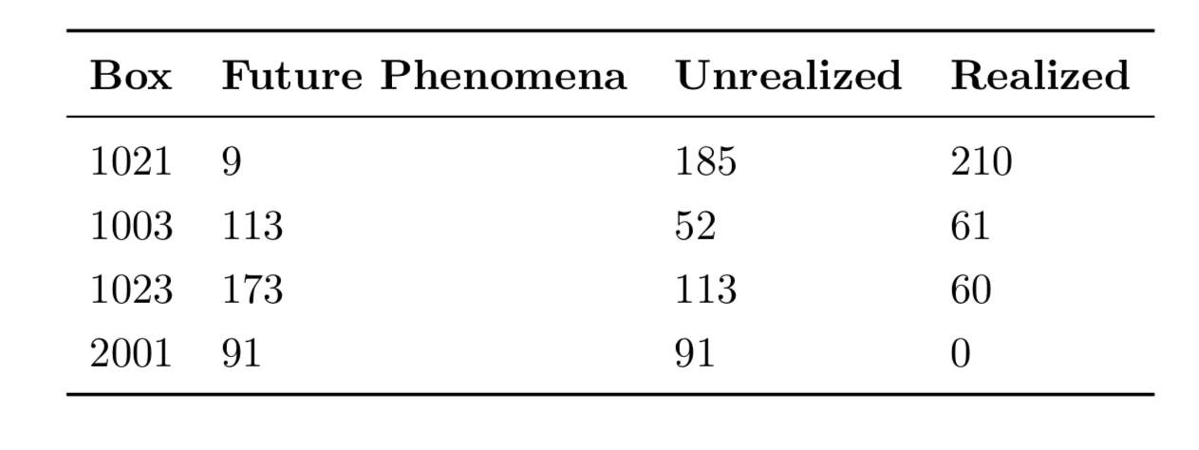
DESIGN: FUTURE PHENOMENA

Slide 42
Design: periodic & future phenomena SELF-OPTIMIZATION
Used to create Future Phenomena
Periodic
Phenomena
Future
Phenomena
Increases Measurement rate and
decrease detection thresholds
enabling more accurate Periodic
Phenomena

Slide 43
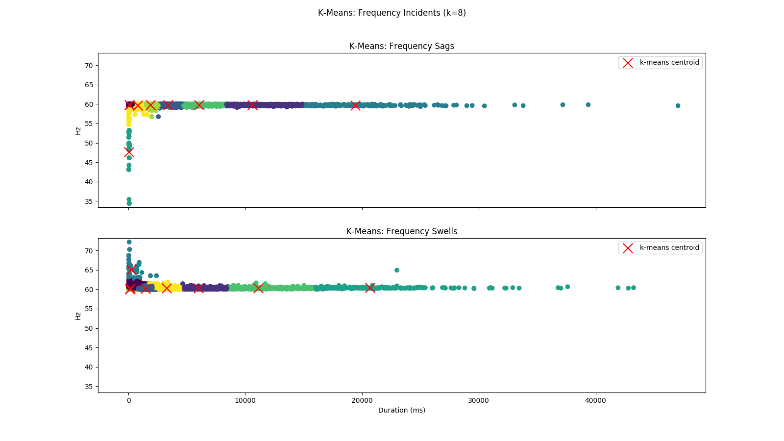
DESIGN: SIMILARITY PHENOMENA

Slide 44
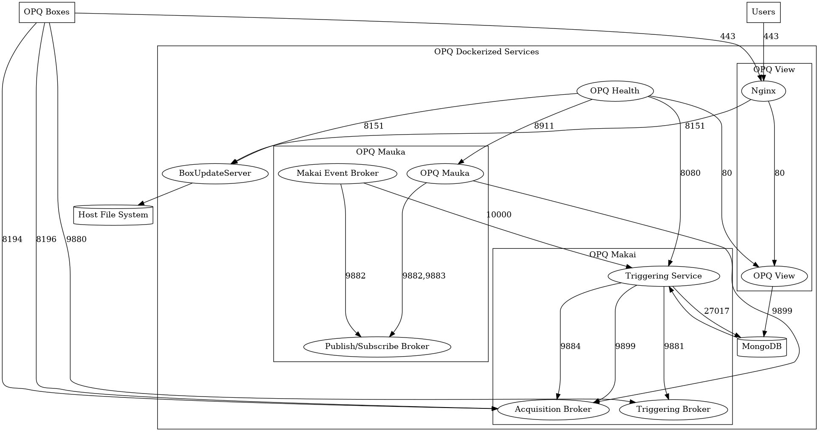
Design of OPQ
OPQ consists of distributed services
Box
Makai/Napali
Mauka
Health
View
MongoDB

Slide 45
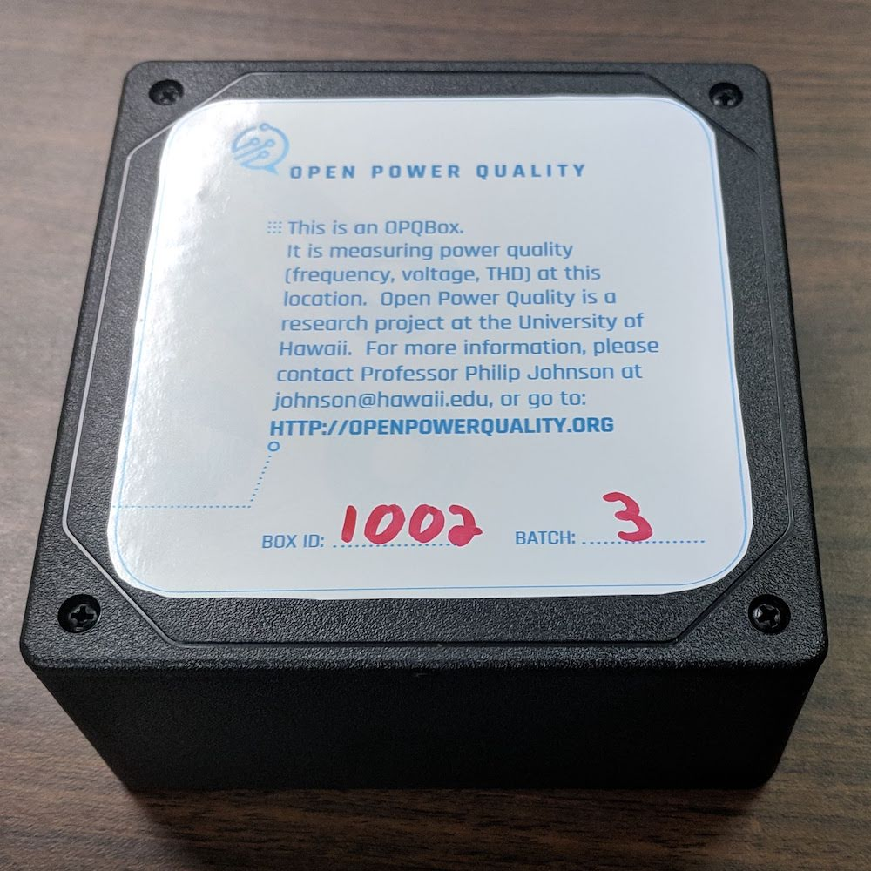
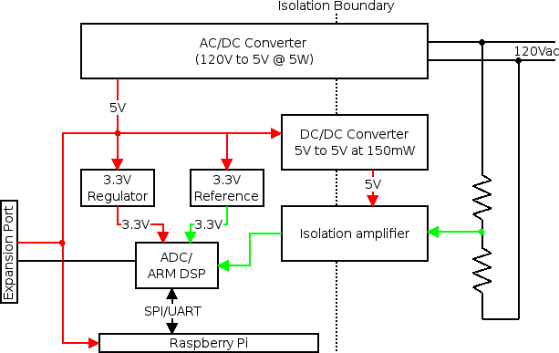
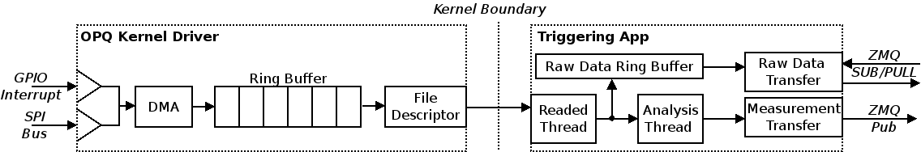
OPQ: Box
Open Source PQ Sensor
12 kHz sampling
Wireless encrypted comms.
Trigger based acquisition
Negrashov 2020

Slide 46
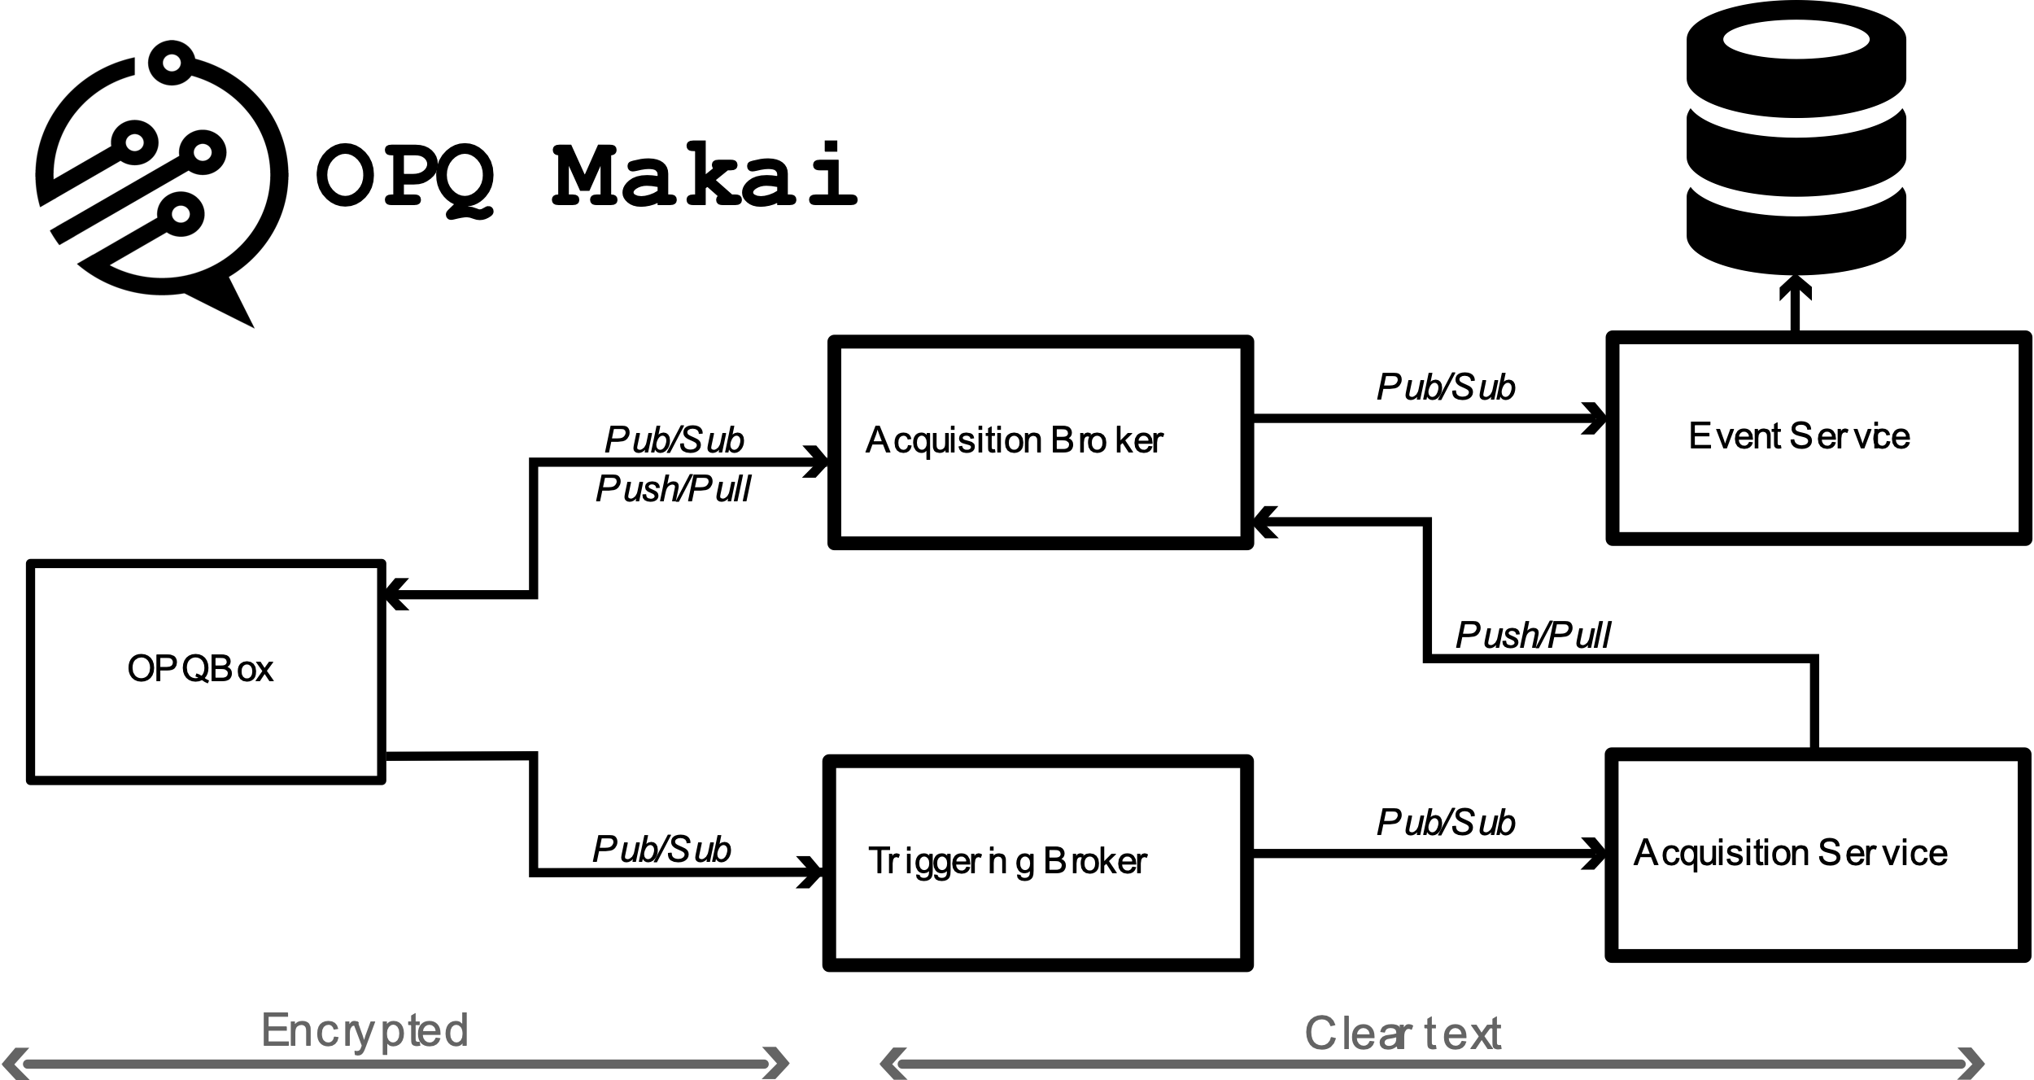
OPQ: Makai/napali
Data acquisition
Triggering
Box communication broker
Negrashov 2020

Slide 47
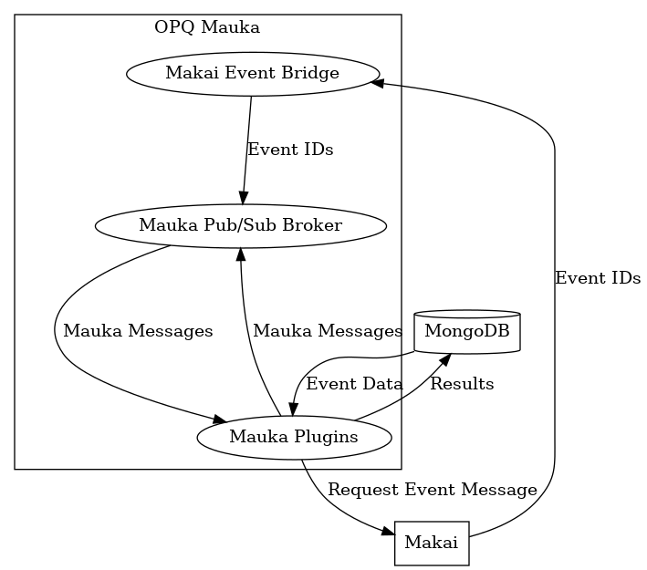
OPQ: mauka
PQ Analysis
Predictive Analytics
Garbage Collection
PQ Plugins (Laha Actors) Providing:
Annotations, base, box optimization, frequency analysis, future phenomena, IEEE1159 voltage analysis, ITIC classification, GC, Makai Event service, mocking capabilities, outage detection periodicity analysis, debugging, Semi-F47 classification, system health/status, metric collection, THD analysis, threshold optimization, transient detection, and triggering

Slide 48
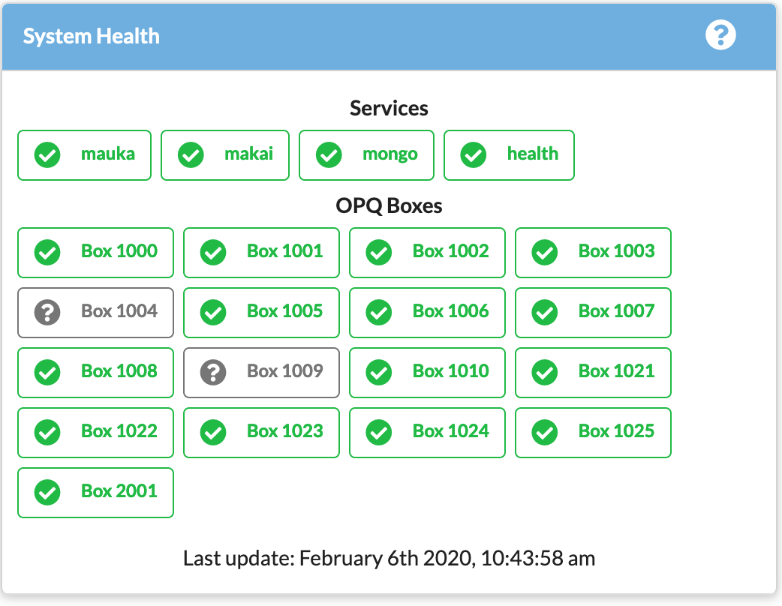
OPQ: Health
Box Monitoring
Service Monitoring
Configurable Alerts

Slide 49
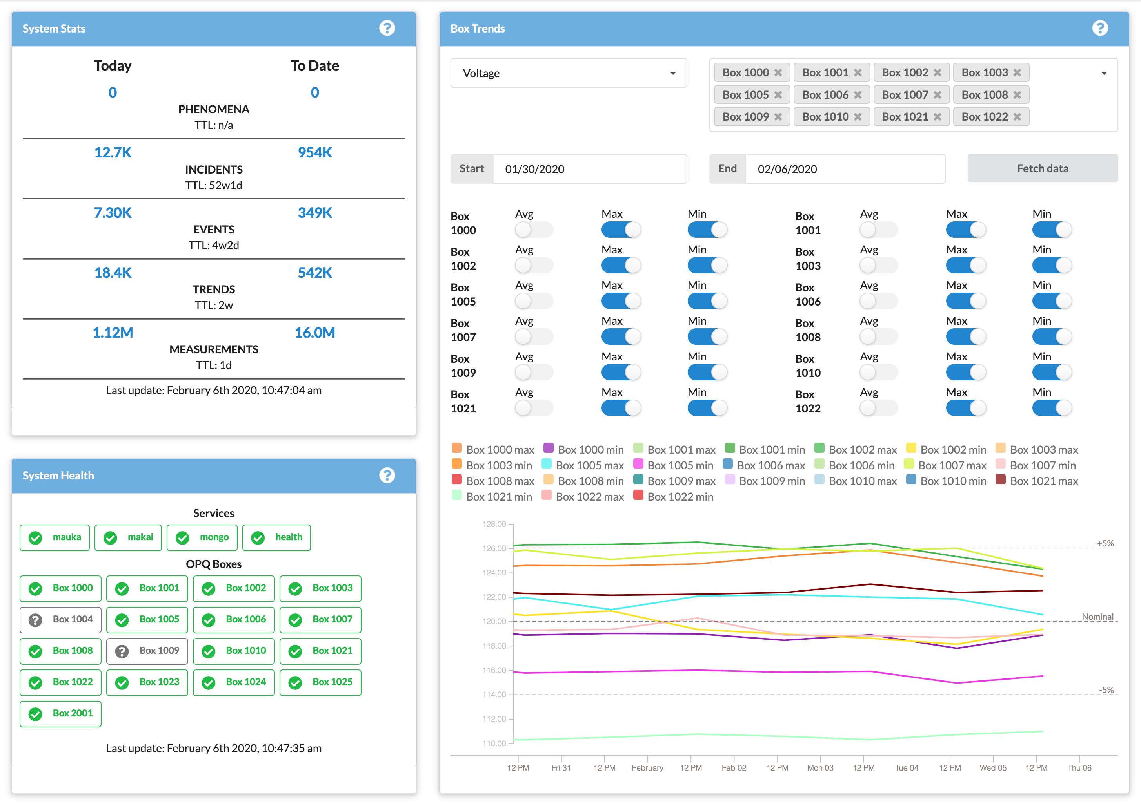
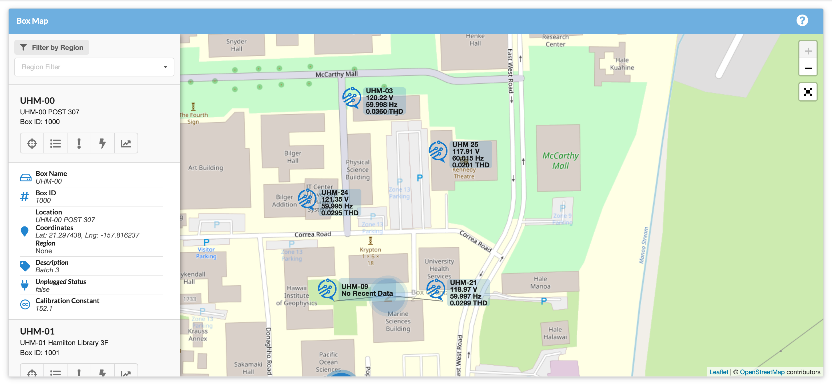
OPQ: view

Slide 50
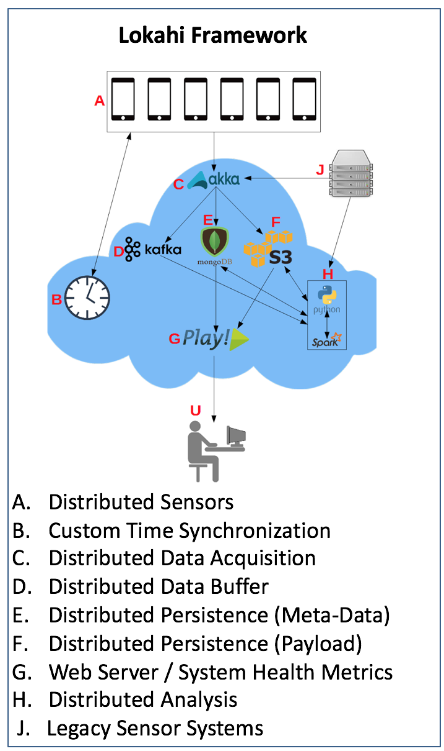
Design of lokahi
Lokahi is made up of several distributed services
Lokahi Sensors
Time Synch Service*
Acquisition Service
Web Service
Analysis Service
Collaboration Service*

Slide 51
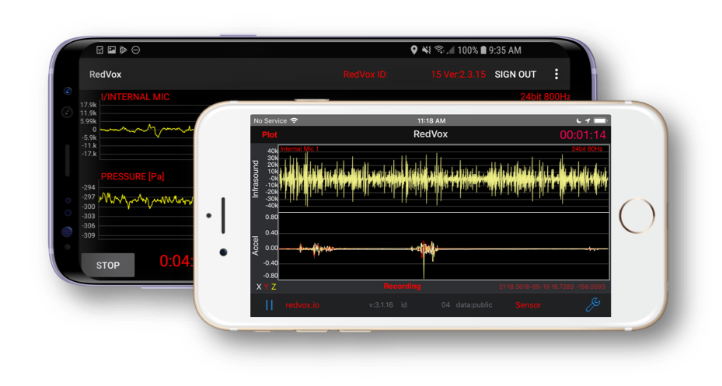
Lokahi: sensors

Slide 52
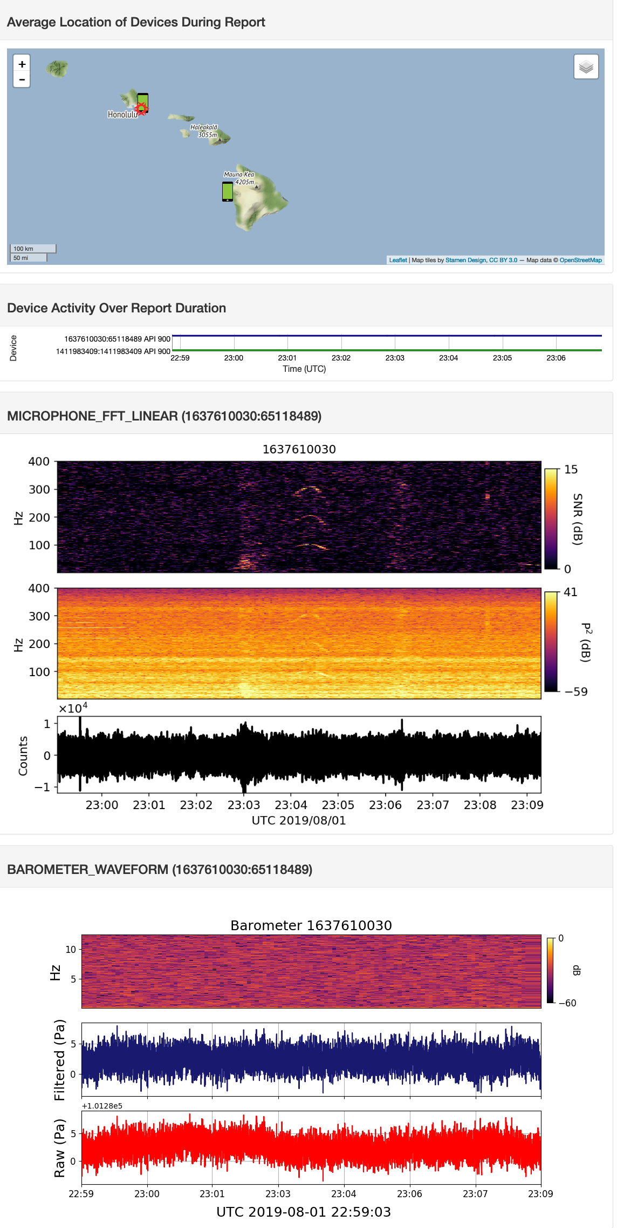



LOKAHI: Web

Slide 53


Lokahi: Analysis
Big Island earthquake
SpaceX launch
Meteor entry above Maui

Slide 54
Evaluation techniques

Slide 55

Evaluation: Deployment of laha reference implementations
OPQ UHM Locations
Accessibility
Co-location with UHM sensors
Topology of UHM micro-grid
Lokahi Locations
Ad-hoc public sensor data

Slide 56


Evaluation of data validation
OPQ
Compare against
GE PQMII
GE EPM7000
Lokahi
Compare against
Bruel & Kjaer Microphone Type 4193
MB3 digital microbarometer
Asmar 2019

Slide 57


Evaluation of generality of laha framework
Design & deploy Laha-compatible DSNs in multiple domains
Collect metrics & results that either confirm or deny benefits claimed by Laha

Slide 58
Evaluation of converting primitive data into actionable insights
Design & Implement Laha Levels
Test efficacy of Laha Levels
Test efficacy of Phenomena

Slide 59


Evaluation of big data sensor management: An analytical approach

Slide 60
Evaluation of big data sensor management: A simulated approach

Slide 61

Evaluation of tertiary goals
Design and implement experiments
Collect and discuss metrics
Optimizations for triggering, detection, classification
Used to create Future Phenomena
Periodic
Phenomena
Future
Phenomena
Increases Measurement rate and
decrease detection thresholds
enabling more accurate Periodic
Phenomena

Slide 62
RESULTS

Slide 63



Results of data validation
OPQ Events vs Ground Truth

Slide 64

Results of generality of laha: OPQ

Slide 65

Results of generality of laha: OPQ

Slide 66




Results of generality of laha: OPQ

Slide 67

Results of generality of laha: Lokahi
Full results available at redvox.io
Meteor Entry over Maui
SpaceX Falcon 9
Big Island Earthquake
Hurricane Lane

Slide 68
Results of converting primitive data into actionable insights: Laha level hierarchy

Slide 69
Results of converting primitive data into actionable insights: annotation phenomena
Description | Boxes | Events | Incidents
Oahu Storm | 16 | 4 | 400
Makiki Outage | 16 | 1 | 143
Manoa Outage | 15 | 1 | 168

Slide 70

Results of converting primitive data into actionable insights: PERiodic phenomena

Slide 71
Results of converting primitive data into actionable insights: FUTURE phenomena

Slide 72



Results of converting primitive data into actionable insights: similarity phenomena

Slide 73



Results of tiered management of big data: OPQ

Slide 74



Results of tiered management of big data: Lokahi

Slide 75
Results of tertiary goals
Used to create Future Phenomena
Adaptive optimizations for triggering
Dynamically alter measurement rate (1Hz->6Hz)
Adaptive optimizations for detection/classification
Dynamically alter thresholds
37/210 predicted events are sub-threshold
Model of Underlying Sensor Field Topology
Requires more detailed knowledge of grid
Periodic
Phenomena
Future
Phenomena
Increases Measurement rate and
decrease detection thresholds
enabling more accurate Periodic
Phenomena

Slide 76



Discussion on laha suitability for dsns
Sensor Sampling Rate
Network Uptime
Signal-to-Noise
Data Acquisition
Sensor Availability
Numerous Events
Multiple Signal Classifications
Designed for Laha
Other DSNs

Slide 77

Discussion on laha levels
SML*
IML
AML
DFL*
DL
IL
PL

Slide 78
conclusions
Claims
Generality
Convert primitive data into actionable insights
Tiered Big Data management
Tertiary goals
Contributions
Laha design
2 Laha-compatible DSNs
Evaluations of DSNs
Implications for modern DSNs

Slide 79
Future directions
Machine learning
Modifying windows and thresholds
Additional simulations
Altering the Level-hierarchy
Enhanced metric collection
Expanded sensor coverage

